Slide 1
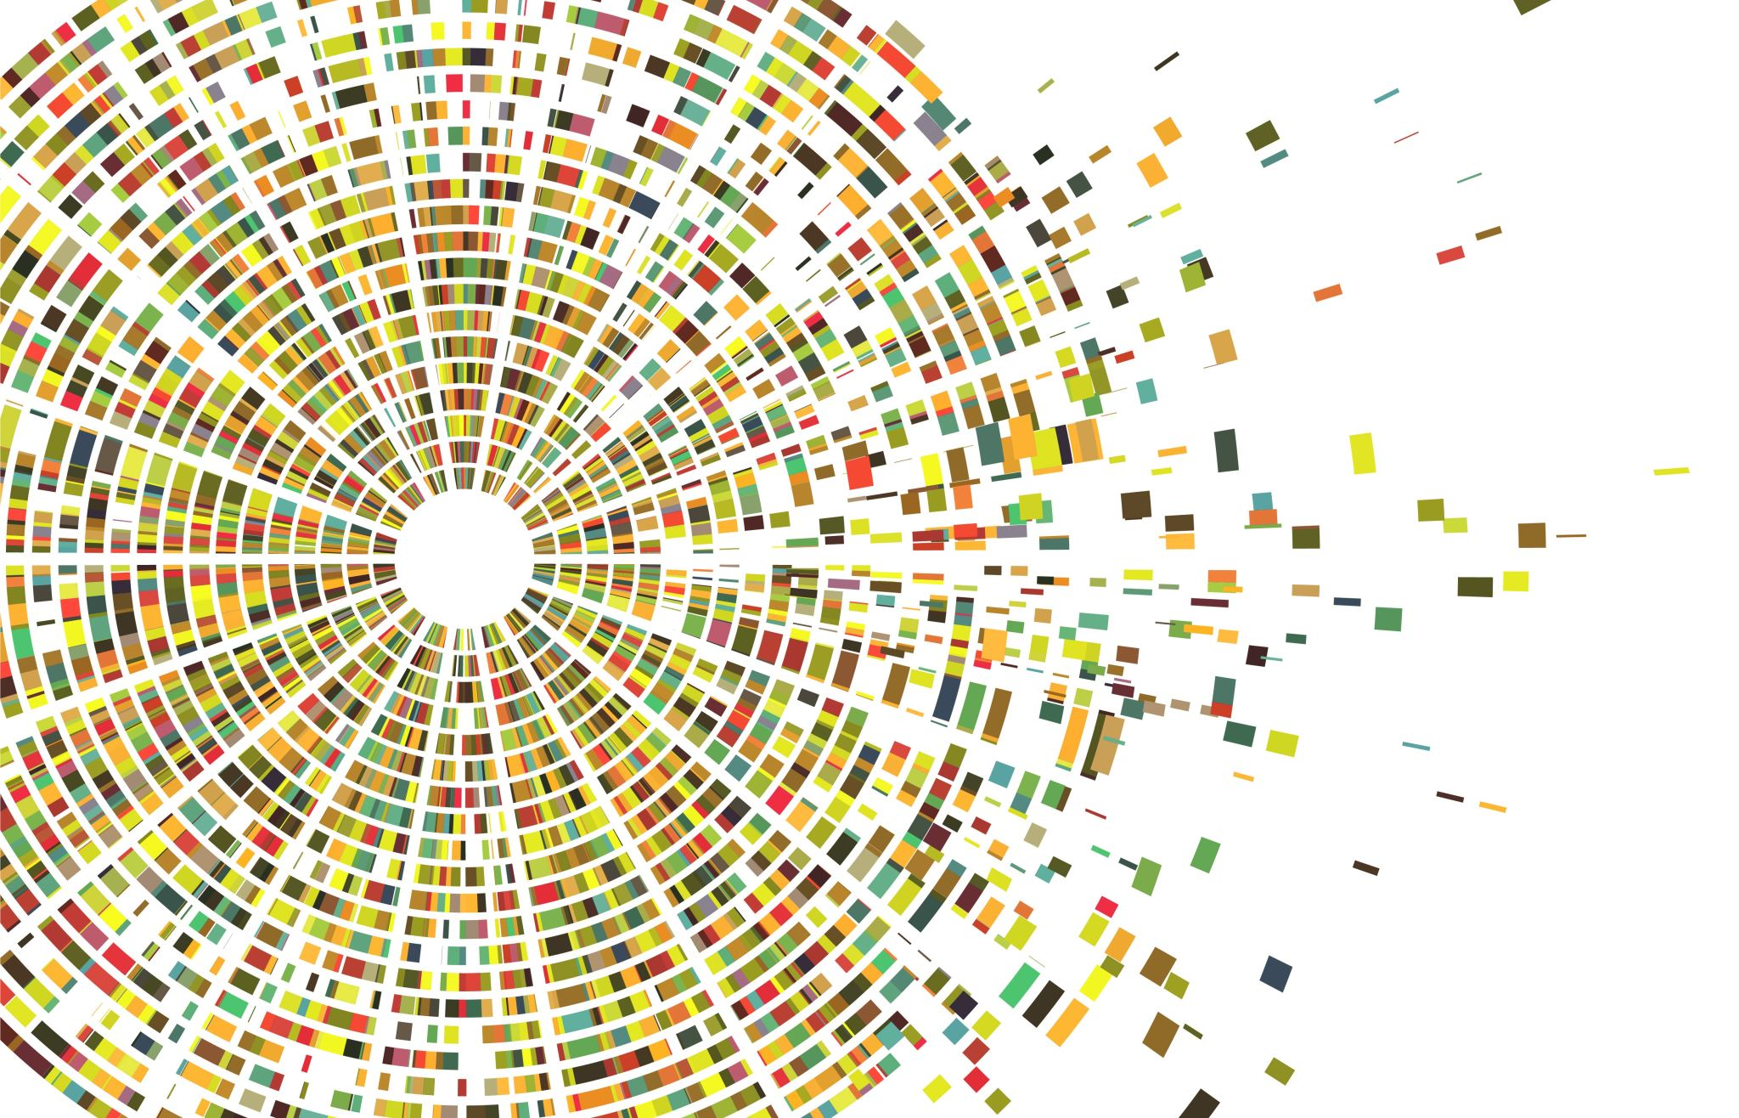
What’s Your Musical DNA?
A Journey through my
Musical Ancestry
Anli Lin Tong 2025

Slide 2
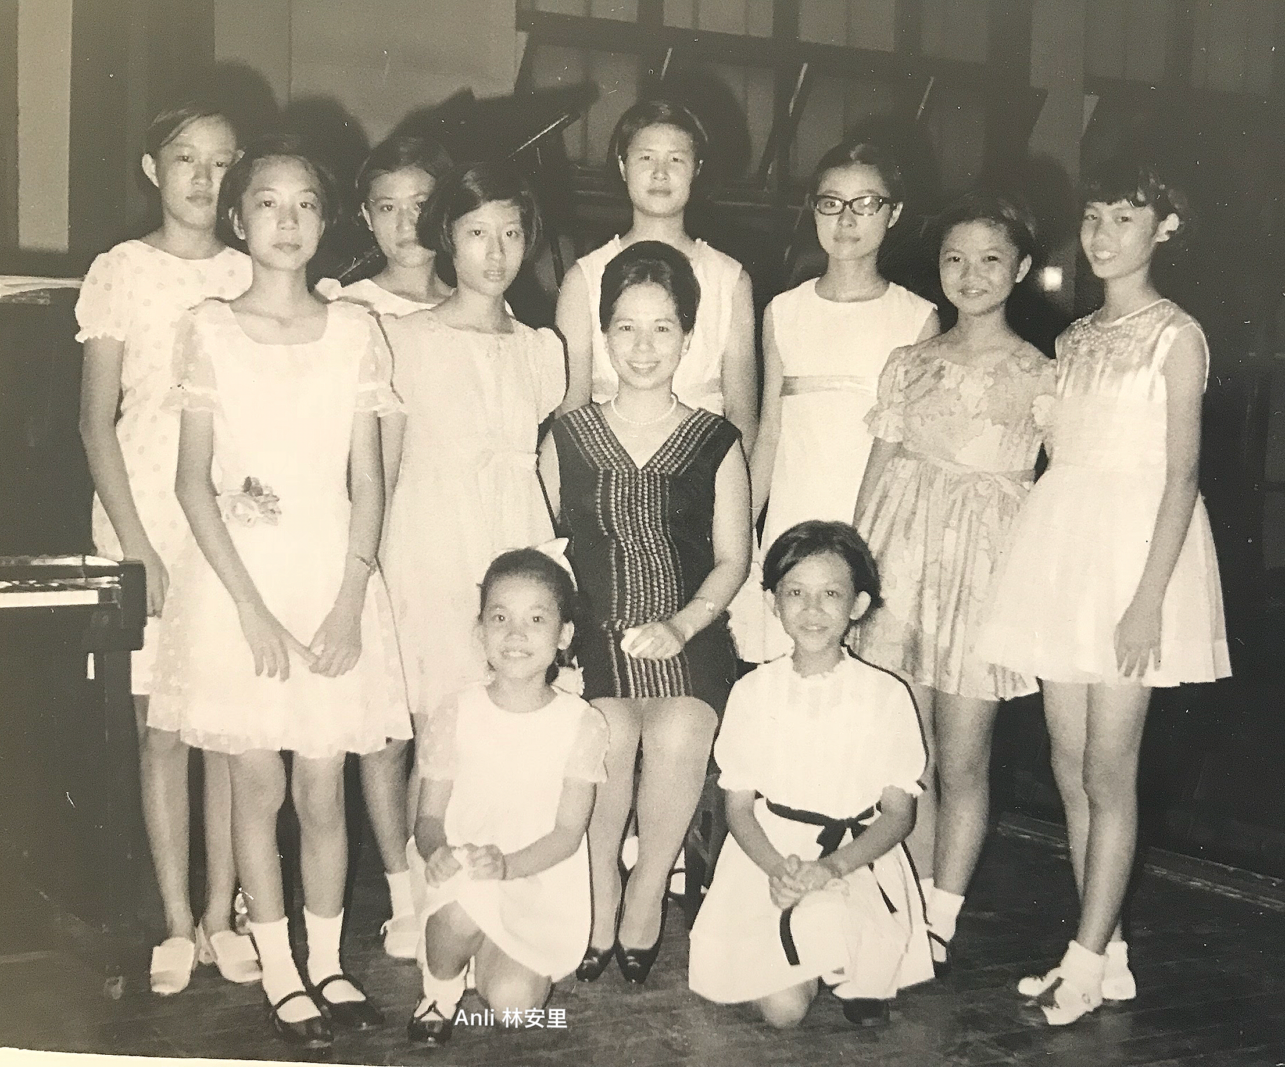
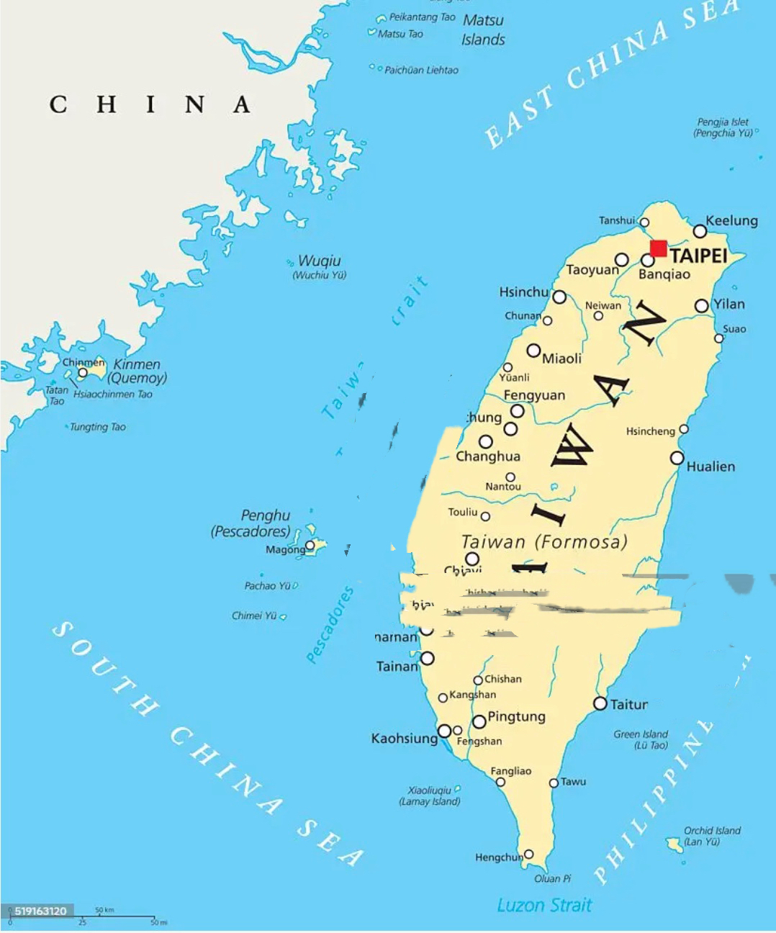
FromTaiwan to U.S.A.
At age 8 in Madame Song’s Piano StudentRecital

Slide 3
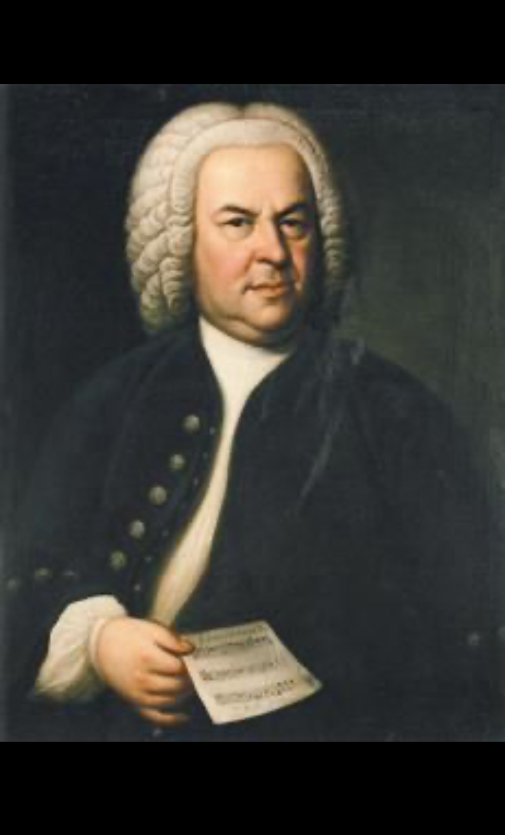
All Roads Lead to….Bach!
A serendipitous message came recently from a Juilliard friend and piano colleague:
Our teacher’s lineage, which all ends up in J.S. Bach, and guess what you have?
Triple-Musical-Blood lines leading to J.S. Bach!
After a little digging,
Following are the traces of your musical ancestries. Munz-Busoni-Liszt-Czerny-Beethoven Canin-Lhevinne-Leschetizky-Czerny-Beethoven
Tzerko - Schnabel-Leschetizky-Czerny-Beethoven
Margulis-His Father-Alexander Scriabin!
Carl Czerny: Germany (1791 – 1857)
Ludwig van Beethoven. German 1770 –1827)
Notes:
Our teacher’s lineage, which all ends up in J.S. Bach, and guess what you have?
Triple-Musical-Blood lines leading to J.S. Bach! After a little digging, Following are the traces of your musical ancestries. Munz-Busoni-Liszt-Czerny-Beethoven Canin-Lhevinne-Leschetizky-Czerny-Beethoven
Tzerko - Schnabel-Leschetizky-Czerny-Beethoven
Coonrod-Schnabel-Leschetizky-Czerny-Beethoven
Margulis-His Father-Alexander Scriabin!

Slide 4
Notes:
"Czerny, the forefather of Pianoforte Technic", illustration from The Etude magazine, April 1927
The famous magazine The Etude, a U.S. magazine dedicated to music, which was founded by Theodore Presser (1848-1925) at Lynchburg, Virginia, and first published in October 1883 and continued the magazine until 1957, brought in its issue of April 1927 an illustration showing how Carl Czerny should be considered the father of modern pianistic technique and base an entire generation of pianist that extends to the present day.

Slide 5
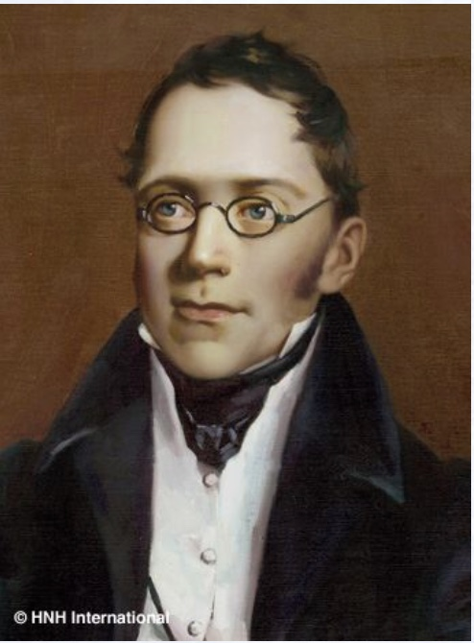
Ludwig van Beethoven Karl Czerny Germany 1770-1827 Germany 1791-1857
Czerny was one of Beethoven’s most best known students
And later became one of the main teachers of Franz Liszt

Slide 6
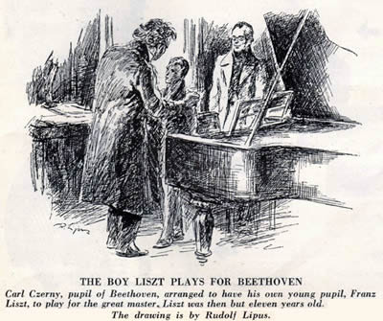
Liszt became Czerny's most famous pupil. He trained the child with the works of Mozart, Beethoven, Clementi, Ignaz Moscheles and Johann Sebastian Bach. The Liszt family lived in the same street in Vienna as Czerny, who was so impressed by the boy that he taught him free of charge. Liszt was later to repay this confidence by introducing the music of Czerny at many of his Paris recitals.^{[15]} Shortly before Liszt's Vienna concert of 13 April 1823 (his final concert of that season), Czerny arranged, with some difficulty (as Beethoven increasingly disliked child prodigies) the introduction of Liszt to Beethoven. Beethoven was sufficiently impressed with the young Liszt to give him a kiss on the forehead.^{[16]} Liszt remained close to Czerny, and in 1852 his Études d'exécution transcendante were published with a dedication to Czerny.^{[17]}
Notes:
Czerny introduces his pupil Franz Liszt to Beethoven. Drawing by Rudolf Lipus (1893–1961).
Rudolf LIPUS (1893–1961) - http://etudemagazine.com/etude/1936/11/BOY_LISZT_PLAYS_FOR_BEETHOVEN_001.jpg – The Etude
THE BOY LISZT PLAYS FOR BEETHOVEN Carl Czerny, pupil of Beethoven, arranged to have his own young pupil, Franz Liszt, to play for the great master. Liszt was then but eleven years old. In writing, later, of this meeting, Liszt said, "I played the first movement of the Concerto in C major; and, when I had finished, Beethoven grasped me with both hands, kissed me on the forehead very softly and said, "Go, thou art blessed; because you will bring joy and blessings to many others. There is nothing finer or more beautiful in all the world." The drawing is by Rudolf Lipus.

Slide 7
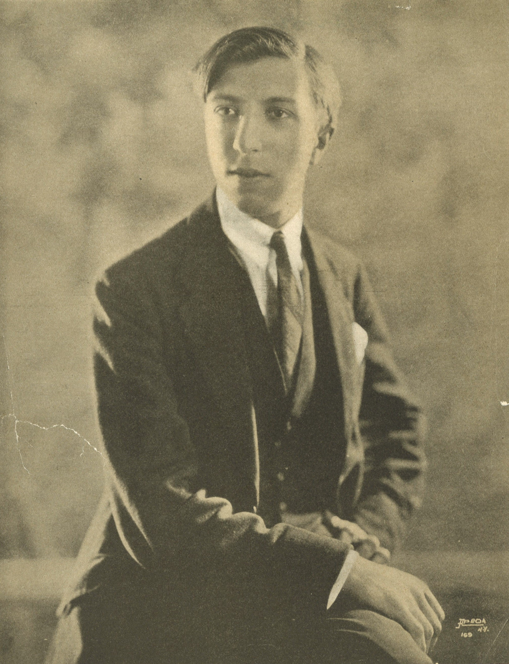
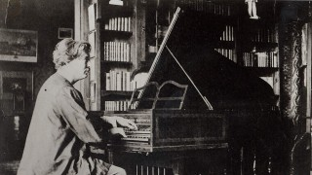
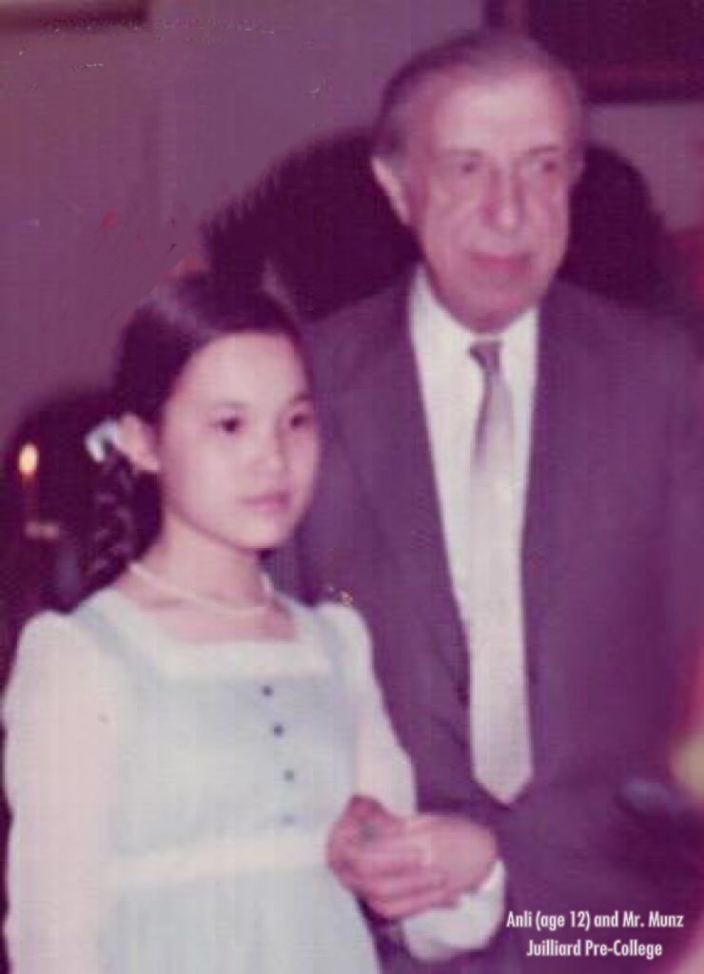
Miecyzslaw Munz Poland – Berlin – U.S.A.
Born in Krakov, Poland, Munz studied in Berlin with Feruccio Busoni and became Busoni’s assistant. He was invited by Josef Hofmann to join the piano faculty at the Curtis Institute in Philadelphia, and later at Juilliard, Peabody and Manhatttan School of Music.
Mieczyslaw Munz 1900-1976
“Lion of the Piano” Feruccio Busoni was an
ardent follower of J.S. Bach.
“Ferruccio Busoni is the most influential and controversial figure of the piano world, who shaped technical and psychological aspects of the piano performance in the XX century.”
Notes:
Busoni: Ferruccio Busoni is the most influential and controversial figure of the piano world, who shaped technical and psychological aspects of the piano performance in the XX century. Possibly, the musical direction of his piano art took roots from romanticism, developing through realism and finally towards symbolism. https://www.ivanhovorun.com/hommage-a-busoni

Slide 8
y
Professor Haddad studied with Olga Samaroff – Stokowski at the Juilliard School.
Samaroff was a student of Eraïm Miria Delconde, a student of
Franz Liszt.
Liszt was one of Czerny’s most important students.

Slide 9
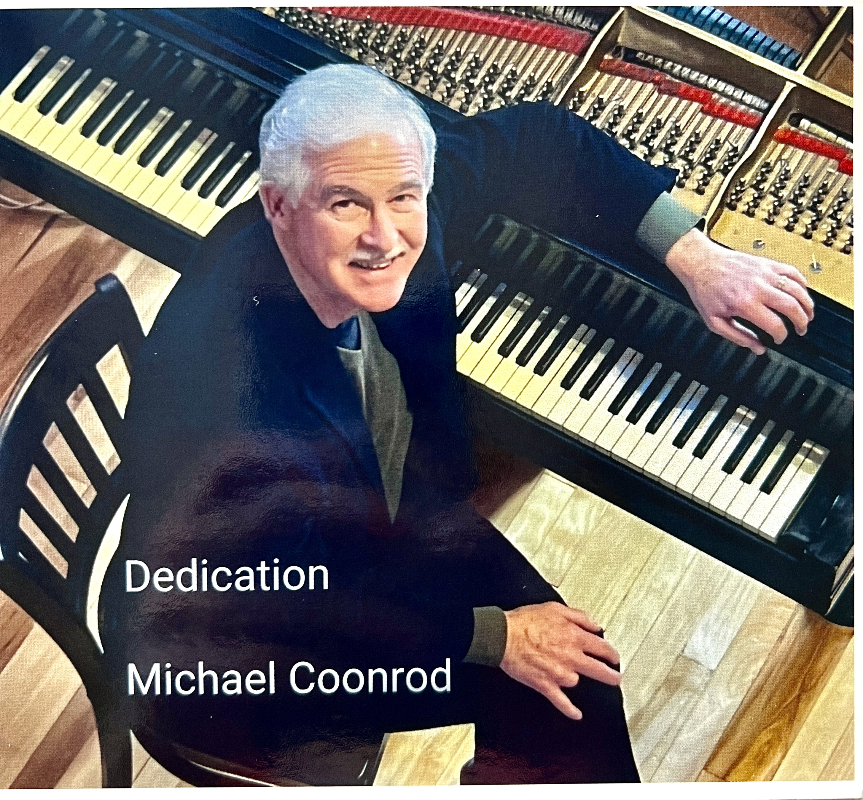
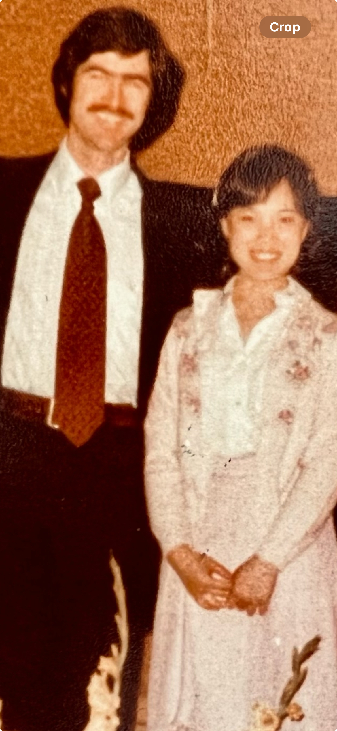
Dr. Michael Coonrod (U.S.A.) – my teacher at Interlochen Arts Academy studied with Konrad Wolff (Germany 1907-1989)
Wolff studied with Arthur Schnabel
(Germany 1882-1951)
Schnabel studied with
Theodore Leschetizky (1830-1915)
Leschetizky studied with Czerny, who studied With Beethoven
Notes:
Schnabel was best known for his devotion to the core German composers, especially the Viennese classics of Mozart, Beethoven and Schubert. He was also renowned for his playing of works by Brahms and Schumann, and he played and recorded works by Bach.
However, his repertoire was wider than that. During his young virtuosic years in Berlin, he played works by other composers including Liszt, Chopin and Weber. On his early American tours, he programmed works such as the Chopin Preludes and Schumann's Fantasie in C.^{[13]} Among other works that he played, as recalled by those such as Claudio Arrau and Vladimir Horowitz, who had heard Schnabel in the 1920s, were Chopin's E minor Piano Concerto and the Piano Sonata No. 2 in B-flat minor, and Weber's Konzertstück in F minor, Piano Sonata No. 2, and Invitation to the Dance.^{[14][15]} Schnabel himself mentioned that he had played the Liszt Sonata in B minor "very often", as well as the Liszt E-flat Piano Concerto.^{[3]}
It is not clear why Schnabel dropped those from his performing repertoire in the 1930s, after his final departure from Germany. He claimed that it was because he decided that he wanted to play only "music which is better than it could be performed".^{[3]} However, it has been suggested by some that "Schnabel, uprooted from his native heritage, may have been clinging to the great German composers in an attempt to keep his cultural origins alive".^{[16]}

Slide 10
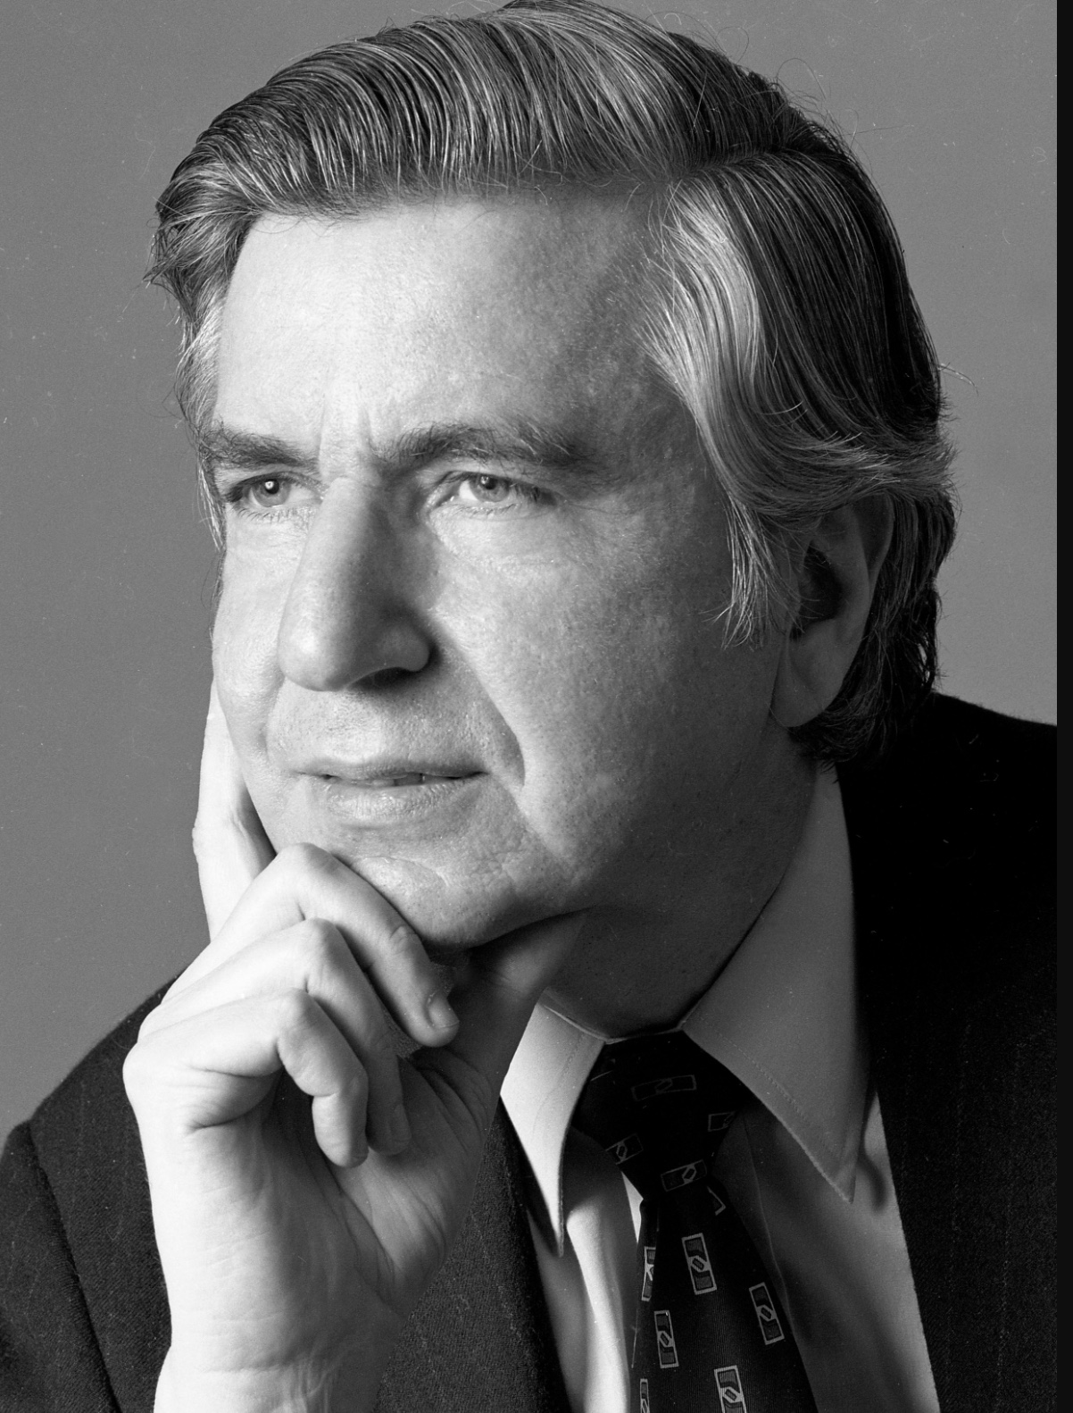
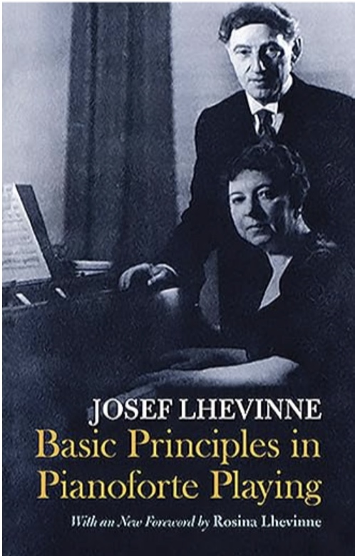
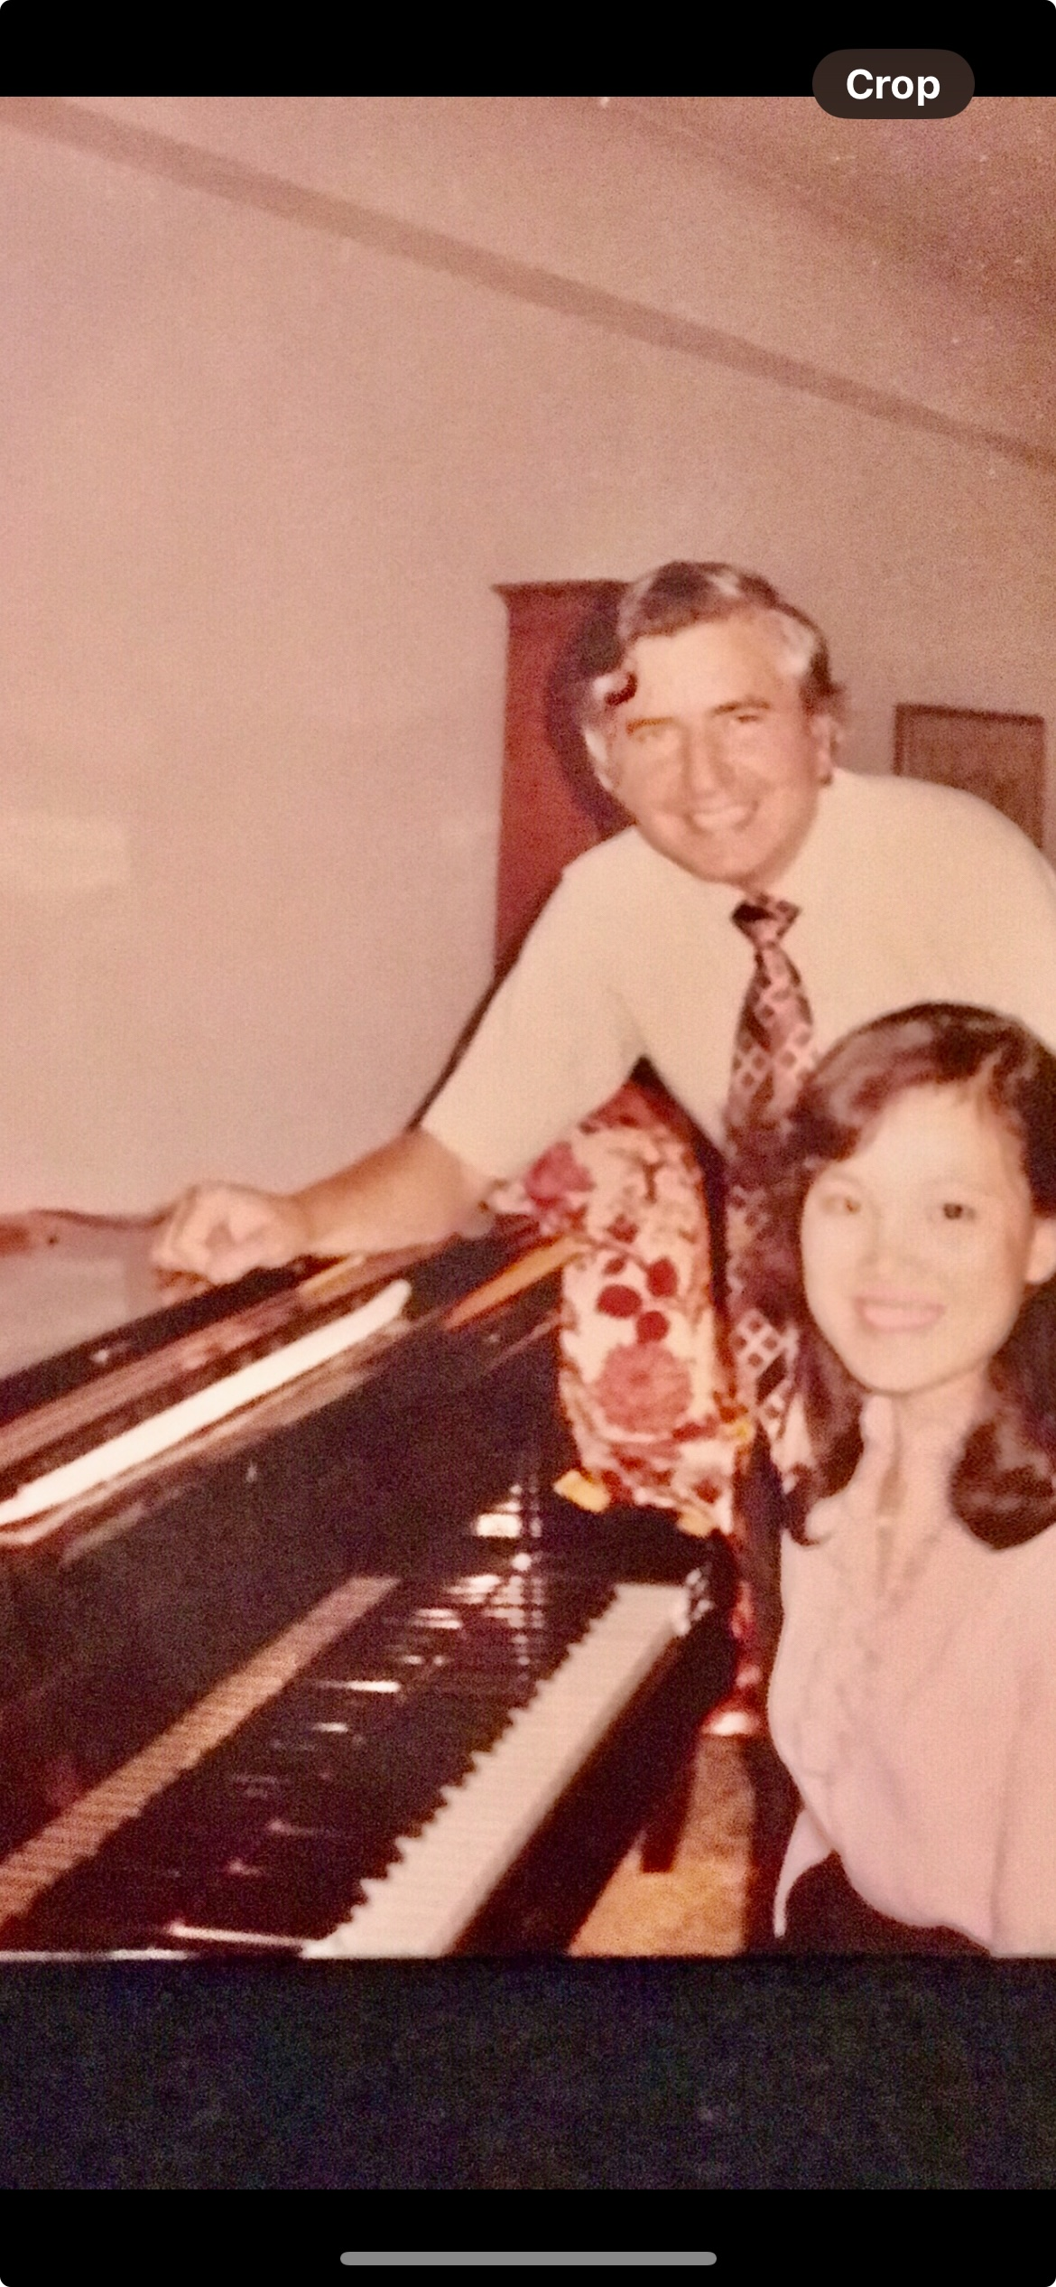
Martin Canin 1930-2019 (U.S.A) The Juilliard School
Student of Rosina Lhevinne; Assistant to Lhevinne at Juilliard until her death and assumed her class at Juilliard.
Rosina Lhevinne
-1880 Kiev, Russian Empire – 1976 New York City
-Studied with and later married Josef Lhévinne ⁽1874 – 1944)
Studied with Vasily Safonov at Moscow Conservatory
Vasily Safonov (1852-1918)
Safanov studied with Leschetizky
Notes:
https://musiccompetition.info/about_eng.html
Rosina Lhévinne (1880-1976) was a pianist and famed pedagogue. Among her students were many of the best young pianists of the 1940s, 50s and 60s, including Van Cliburn. She was a virtuoso performer who delayed a solo career until age seventy-six, twelve years after the death of her husband, pianist Josef Lhévinne.
During the first year of their marriage, the Lhévinnes made their two-piano debut in Moscow. Rosina decided to abandon her solo career and devote all of her musical energies to the support her husband’s. Lhévinne did not resume her own solo performing career until 1956. That year she performed with the Aspen Festival Orchestra. During the following seasons she performed with orchestras around the country. In January of 1963, a few months before her eighty-third birthday, Lhévinne performed Chopin’s Piano Concerto No. 1 in E Minor—the same work she had played at her debut sixty-one years earlier—in four performances with the New York Philharmonic, to great critical acclaim.
In a tribute to Lhévinne after her death in 1976, Peter Mennin, then the president of the Juilliard School, said, “She was quite simply one of the greatest teachers of this century. With her passing, a whole concept of teaching and performing goes with her.”

Slide 11
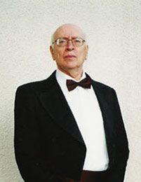
Vitaly Margulis (1928-2011) Ukraine – Russia – Germany – U.S.A.
Early studies with his father who was a student of Alexander Skryabin
Later studies were with the outstanding teacher-methodologist, pianist, professor of the Leningrad Conservatory — Samariy Ilyich Savshinsky, the founder of the Special Music School at the Leningrad Conservatory.
Notes:
Vitaly MARGULIS (piano)
Vitaly Margulis, pianist, pedagogue and author of music philosophy studies, was born in 1928 in the Ukraine. He received his first piano lessons from his father, and then continued his studies with Prof. S. Savshinsky at the Special Music School and later at the Leningrad Conservatoire. In 1958–1974 he conducted his own piano class at the Conservatoire at the same time pursuing a triumphant performance career.
In 1974 Vitaly Margulis left Russia and in 1975 became a professor at the Music School in Freiburg, Germany. In 1994, he accepted the post of Professor of Piano at the University of California in Los Angeles. His concerts in New York, Los Angeles, Rome, Berlin, Salzburg, Amsterdam, Tokyo, Moscow, and Saint Petersburg, as well as his numerous recordings were a great success with the listeners and were highly acclaimed by the critics.
In teaching Prof. Vitaly Margulis prioritizes the study of works by Bach and Beethoven. His book “Johann Sebastian Bach’s Symbolic Language and The Well Tempered Clavier” focuses on the new ways of understanding the religious symbolism and spirituality of Bach’s music.
In the publication “Formula for Timing Relationship and Beethoven’s Timing Principles” Vitaly Margulis explores new concepts in musical architecture. His book “Bagatelles” which was translated and published in six countries describes principles of piano pedagogy in an aphoristic manner. His book “Paralipomenon,” published in Moscow in 2006, met with enthusiastic delight.
Vitaly Margulis has been very fortunate as a teacher. His students have won more than a hundred prizes at international competitions over the last decades, twenty eight of them being grand prizes. He has also conducted piano workshops and seminars in Germany, Switzerland, Greece, Belgium, Portugal, Holland, France, Japan, Russia, and America.
Savshinsky Internation Festival: https://musiccompetition.info/about_eng.html

Slide 12
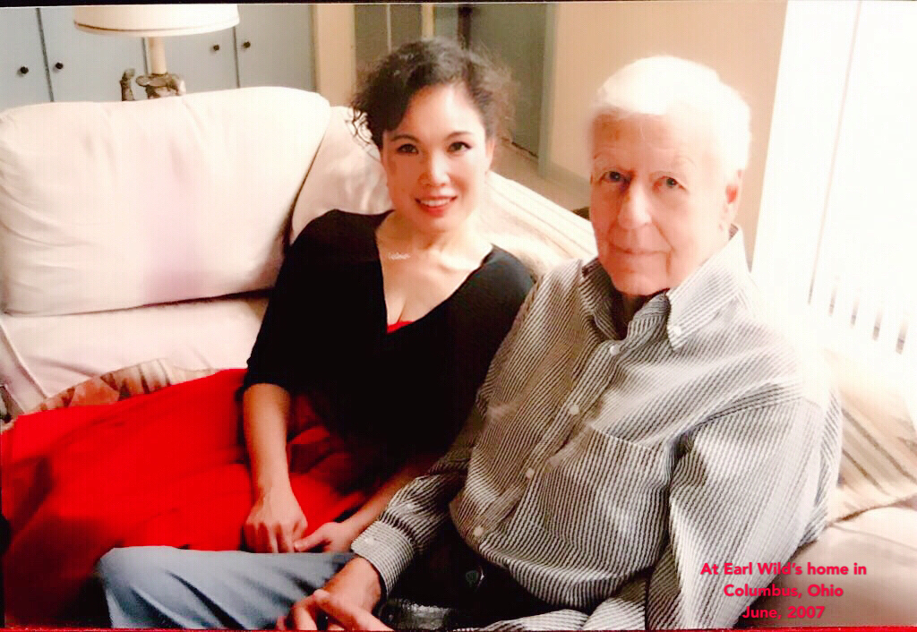
Earl Wild (U.S.A. 1915-2010)
Earl Wild (November 26, 1915 – January 23, 2010) was a celebrated American pianist known for his transcriptions of jazz and classical music who had performed for four consecutive American presidents.
studied with Egon Petri
(Dutch-American pianist 1881-1962)
Petri studied with Feruccio Busoni (Italy1866- Berlin1924)
Busoni studied with Leschetizky (Poland1830- Germany1915)
Leschetizky studied with Czerny (Vienna 1791-1857)
Czerny studied with Beethoven(Germany1770 - Autria1827)

Slide 13
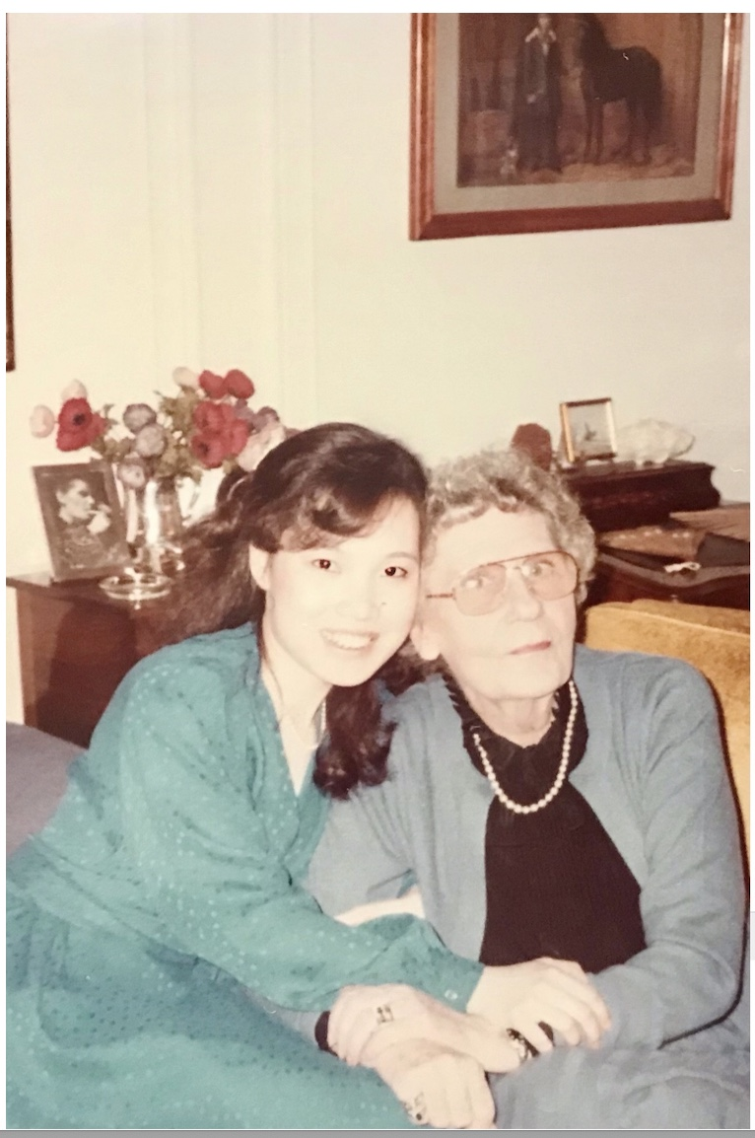
Nature vs Nurture: an anecdote Laura: my improbable connection to the Napoleonic Era – and 18th century European Aristocracy!
Biography
Laure Murat was a member of the aristocracy in France.
Née Laure Louise Napoléonne Eugénie Caroline, Princesse
Murat, was born on 13 November 1913 in the 16th arrondissement of Paris. She was the daughter of Michel Charles Anne Joachim Napoléon, Prince Murat, and Helena Mc Donald Stallo. [1]
She married Jean-Paul Frank, publiciste, on 3 August 1931 in Cannes. The witnesses were Prince Napoléon Murat (49 rue du Maréchal
Joffre, Nice) and Princess Eugène Murat (12
avenue d'Eylau, Paris).[21
@wikitree.com — Private
Anli and Laura at Home. West 70th St., NYC
Notes:
So, what happens if one is not “BORN into pedigreed musical lineage?” My improbable meeting and life with Laura may shed some light on what can happen. Realizing the lineage of my 4 year long “roommate” was directly descended from one of history’s most illustrious military families, the Bonapartes and the Marsahll Joachim Murat, I watched the films with avid atteion, feeling suddenly an intense connection because these figures have become real for me. War and Peace with the battle scenes of Napoleon’s army, and the myriad other titles with Napoleon’s names, gripped me in an intensly personal way that surely was the very real connection I now feel. It’s no longer my genes, but the proximity and experiences embedded in my fibers of the lineages of OTHERS that have also enriched and broadened the scope of understanding and emotional involvement in an previously foreign and distant history.
All this to say, what is nature vs nurture? How does this enrich and illuminate the musical landscapes and complexities within each of us?

Slide 14
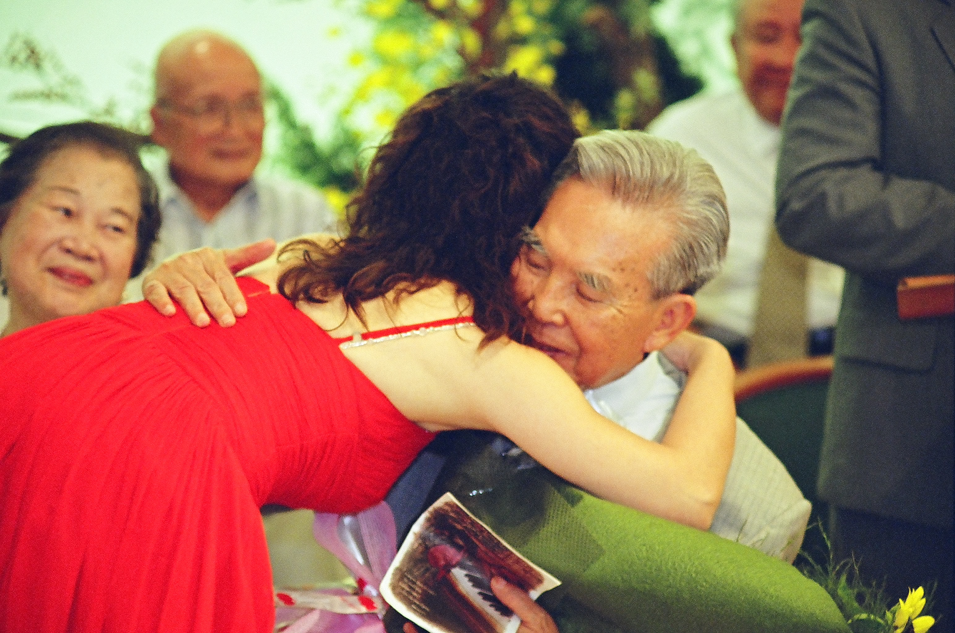
From Formosa with Love
To my late parents:
Gratitude and Love Forever
Performing in Taiwan; rediscovering my roots
Reception by the President
Meeting a reclusive but “National Treasurer” composer
Performing more repertoire by Taiwanese composers:
Ma Shui-Long, Kuo Chi-Yuan Concertino and chamber music of Taiwanese Folk Tunes,
And my father’s music, Taiwan in 4 Movements

Slide 15
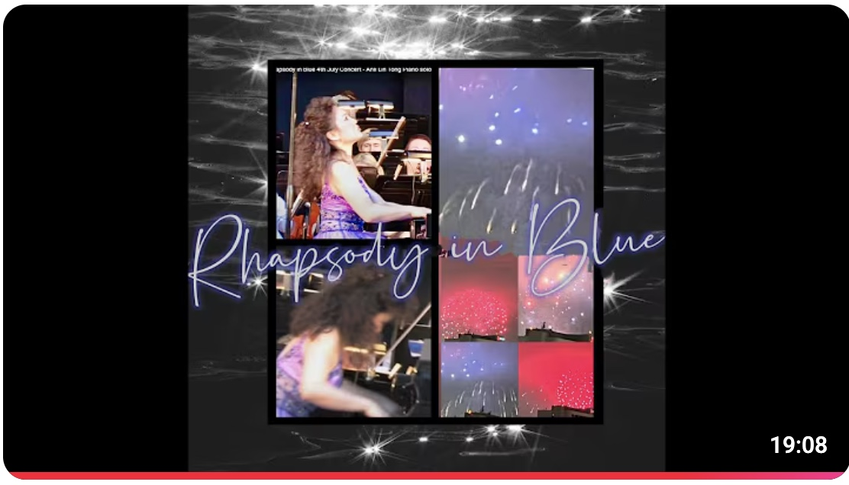
“From Mozart to Tin Pan Alley” Playing Gershwin on Fourth of July
https://www.youtube.com/watch?v=fGvWSalb3Js
Start at 17:00
Notes:
Start from 17:07 https://www.youtube.com/watch?v=fGvWSalb3Js
I became a citizen of the United States on June ? 1989. Playing this ALL-American Concerto at the Starlight Bowl on July Fourth was a moving and exhilarating moment of arrival for me.
Concusion: embrace each experience, dig deeply into the world in which your music finds root, and foundation. Enrich yourself through the different styles, periods and sensibilities you are challenged to convey and express. Nature AND nurture together will make you the complete musician you aspire to be.

