Slide 1
A World of Possibilities:
University of Nebraska at Omaha
Keyboard Area’s Project Recital initiative
Dr. Kristín Jónína Taylor
Associate Professor of Piano
University of Nebraska
at Omaha

Slide 2
What is a Project Recital?
Repertoire Awareness
Community engagement
Shared vision

Slide 3
Let’s talk about:
Choosing a Topic
Finding Composers/ Compositions
Accessing Music Scores

Slide 4
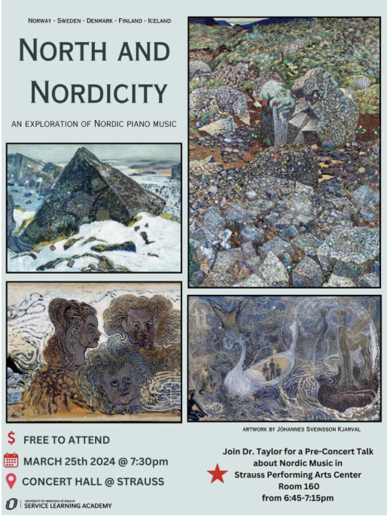
How to pick a topic?
**Student Led**
Standard Repertoire
Composer Anniversaries
Technique Problems
Genres
Historically ignored composers

Slide 5
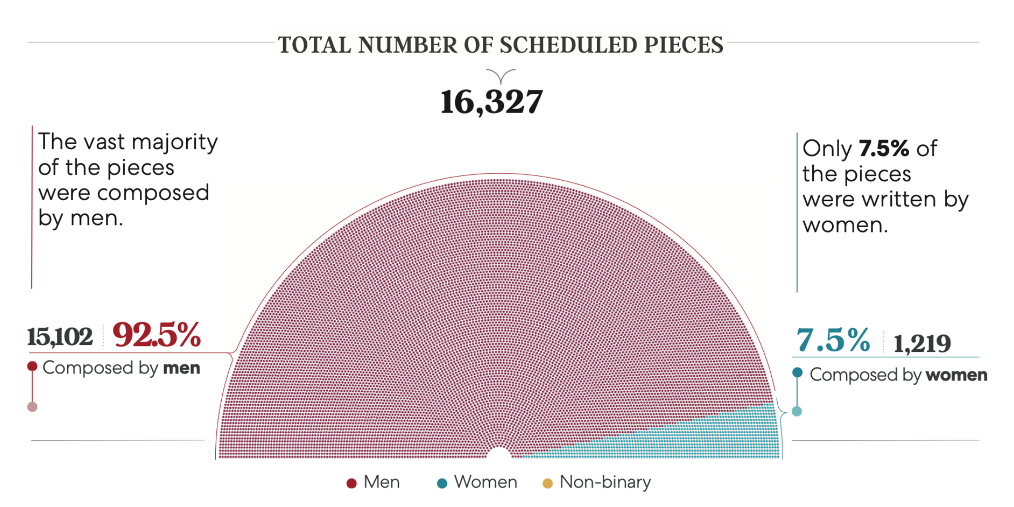
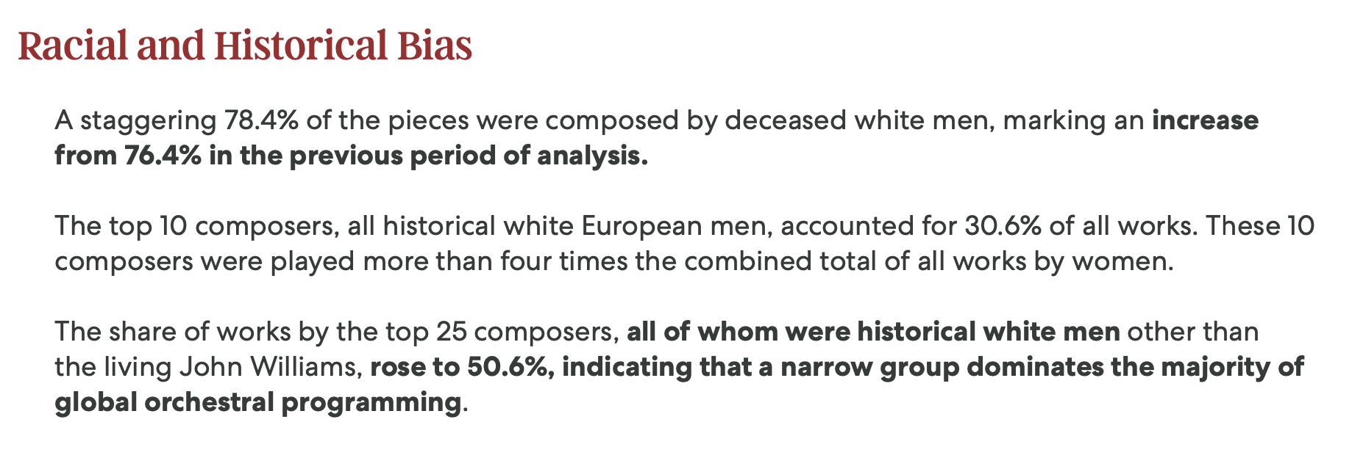
Repertoire programming by symphony orchestras worldwide
Source: Equality & Diversity in Global Repertoire: Orchestras Season, by Donne, Women in Music, donne-uk.org, 2024.

Slide 6
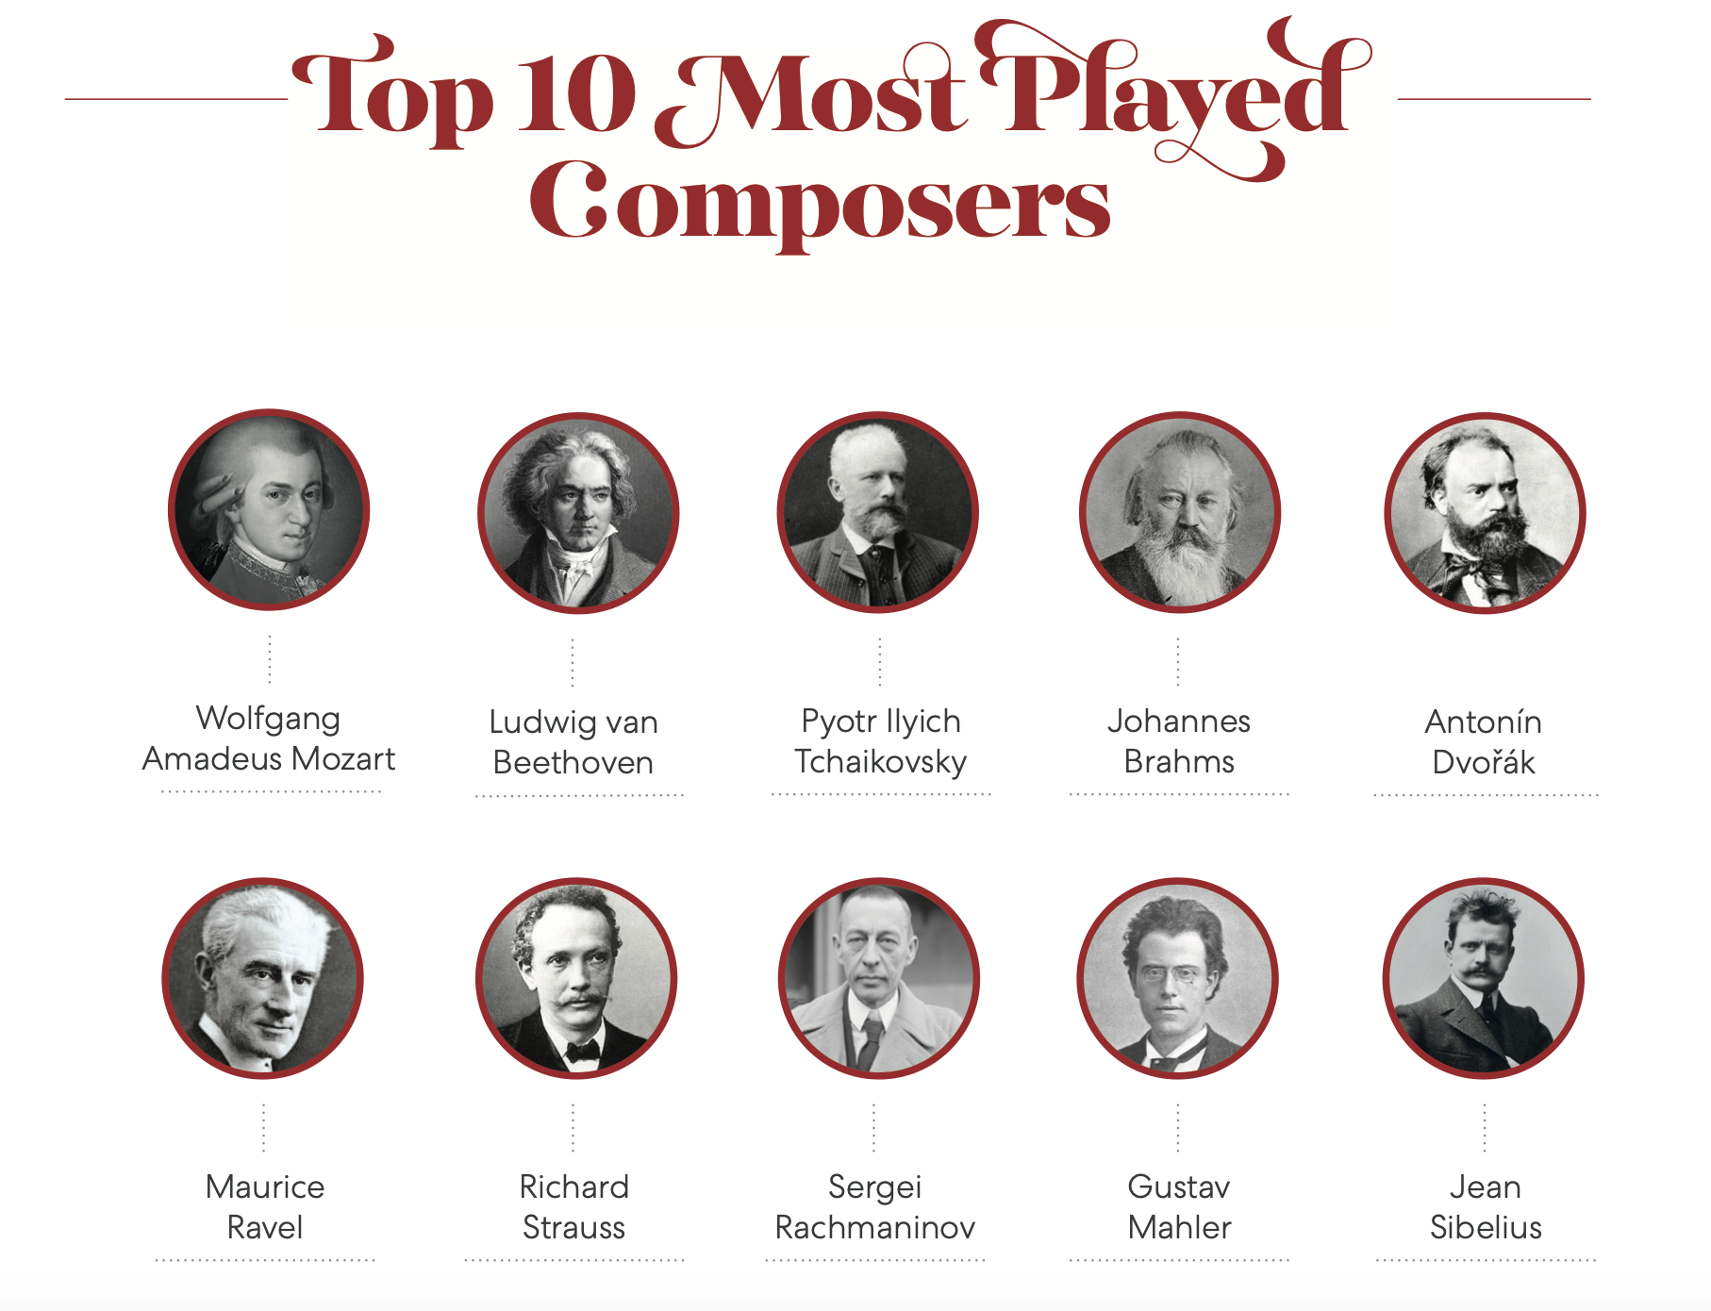
Source: Equality & Diversity in Global Repertoire: Orchestras Season, by Donne, Women in Music, donne-uk.org, 2024.

Slide 7
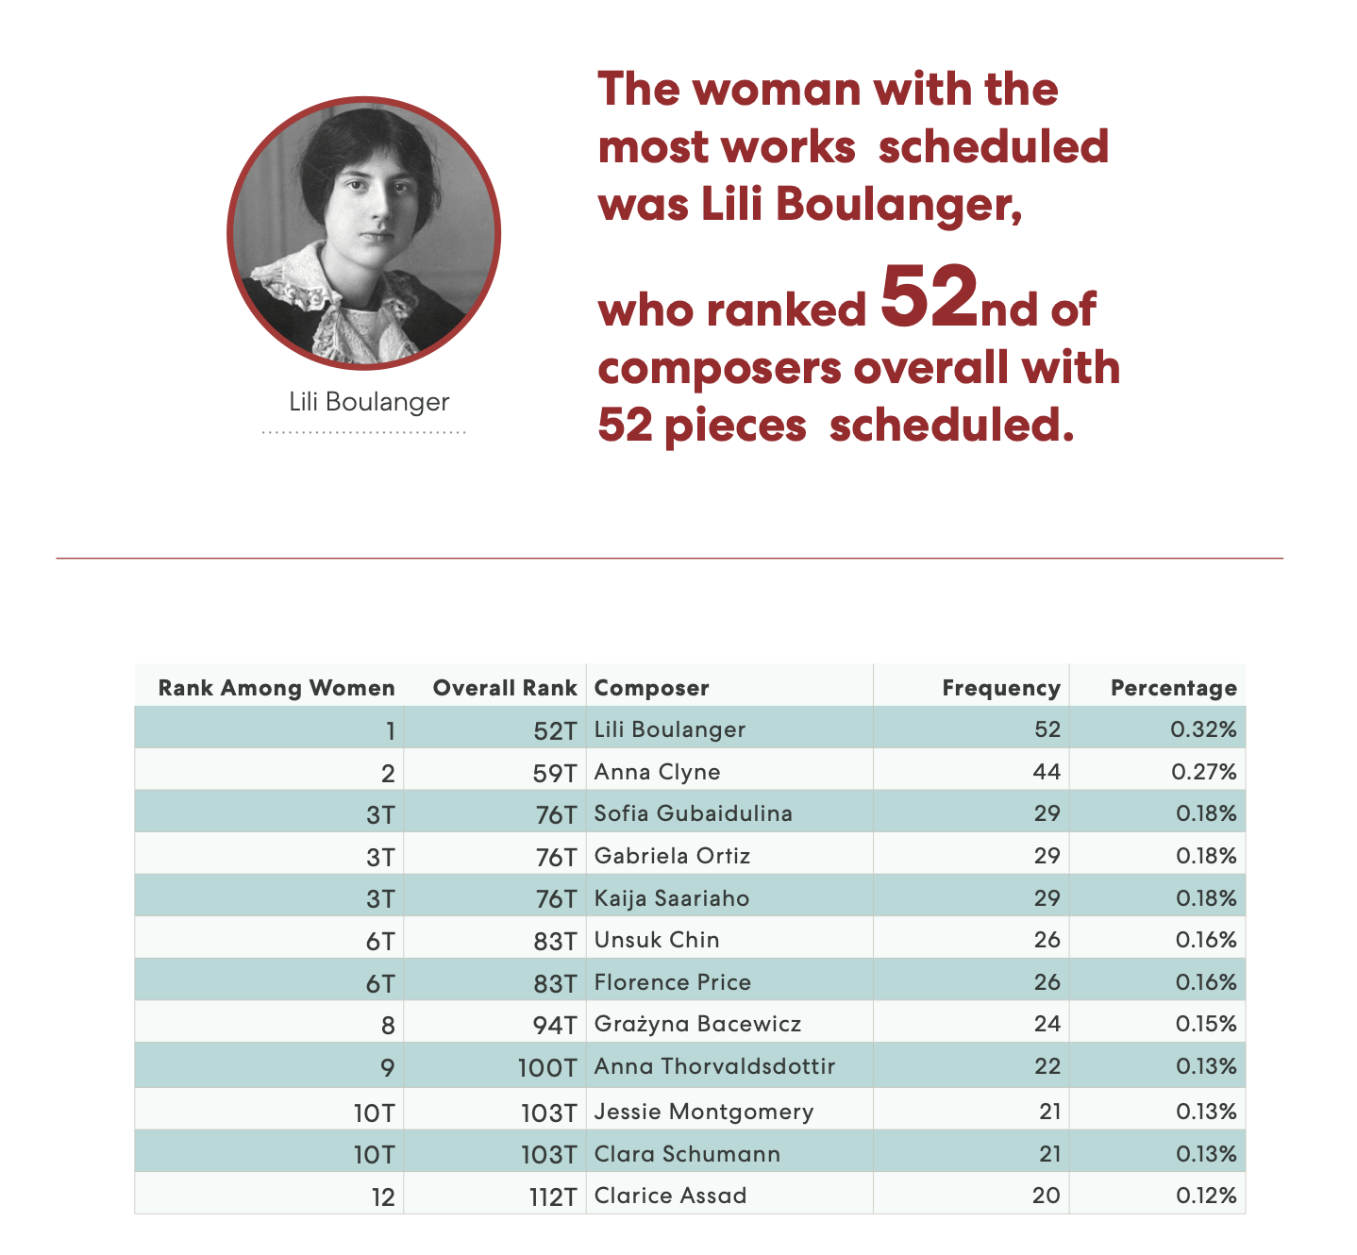
Source: Equality & Diversity in Global Repertoire: Orchestras Season, by Donne, Women in Music, donne-uk.org, 2024.
National origin of composers on this list:
Brazil
Finland
France
Germany
Great Britain
Iceland
Mexico
Poland
Russia
South Korea
United States
Living composers: 7
Historical composers: 5

Slide 8
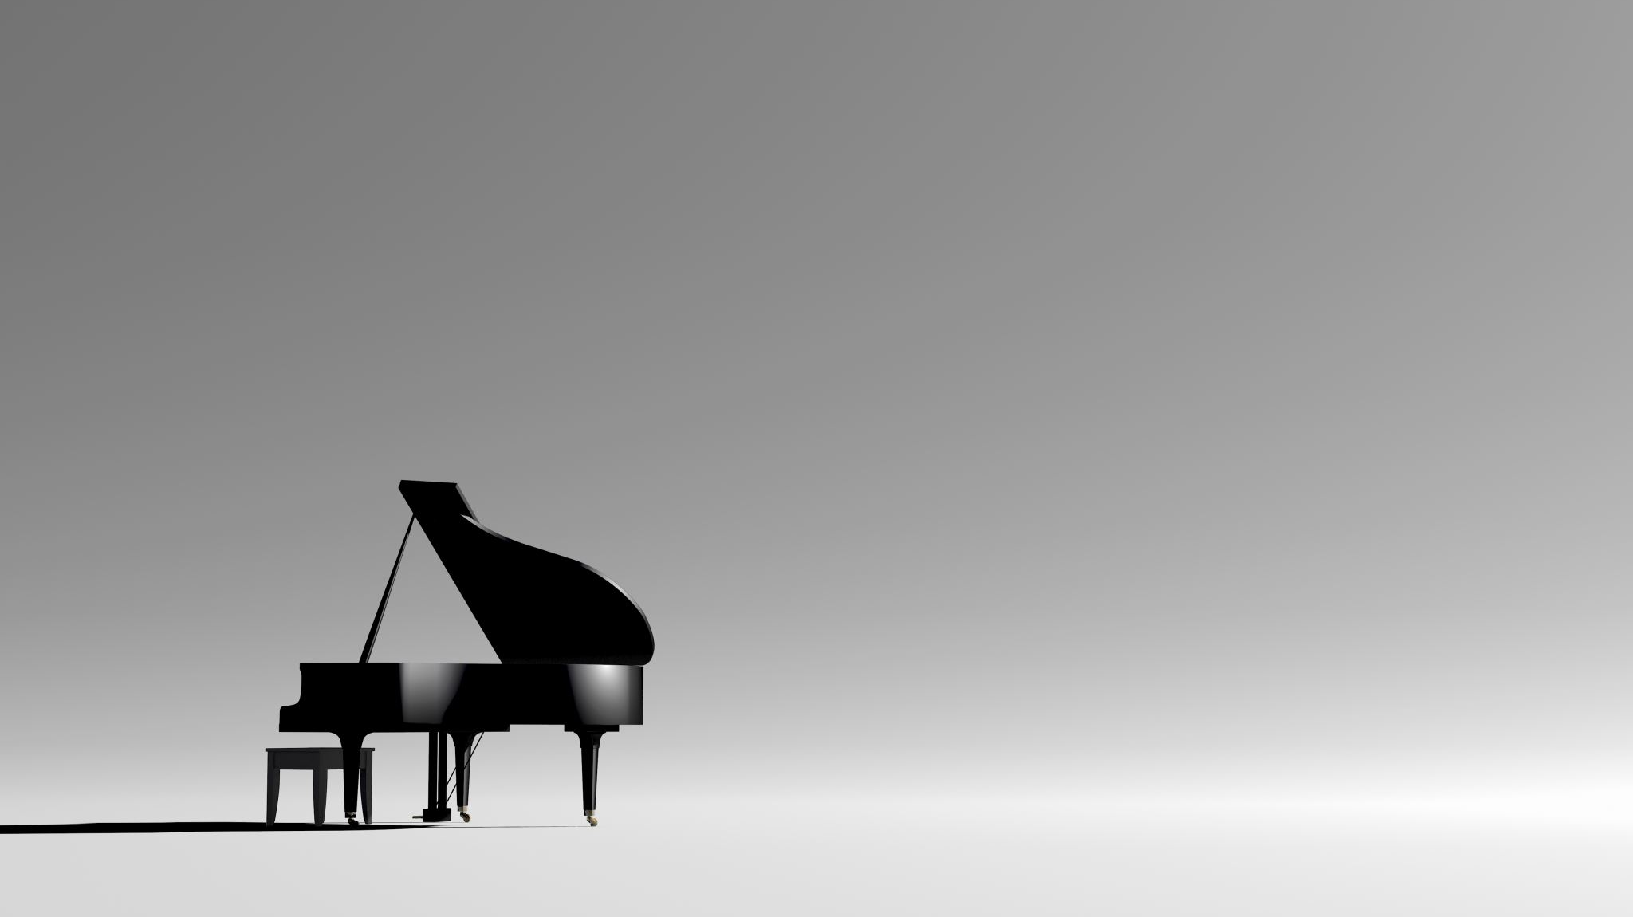
taylor piano studio repertoire Fall 2023→Spring 2024 → fall 2024 compilation
“An imperfect response is better than no response at all…”

Slide 9
Project Recital Topics:
Spring 2017 – Debussy Preludes Spring 2018 – Women Composers Fall 2019 – Music for Left Hand Spring 2020 – Beethoven 250 Fall 2020 – Heritage Recital (composers from each student’s cultural background) Spring 2021 – African-American/Black Music Fall 2021 – Latin American Music Spring 2022 – Baroque Music ("Anything But Bach") Fall 2022 – Women Composers Spring 2023 – Extended Techniques Fall 2023 – Nocturnes Spring 2024 – Nordic Music Fall 2024 – Living Composers Spring 2025 – French Music

Slide 10
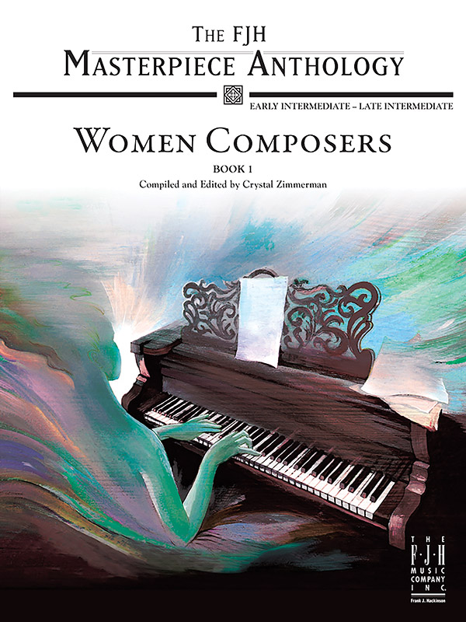
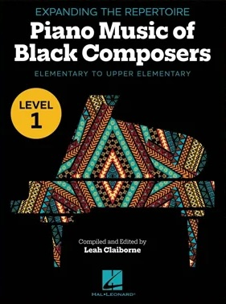
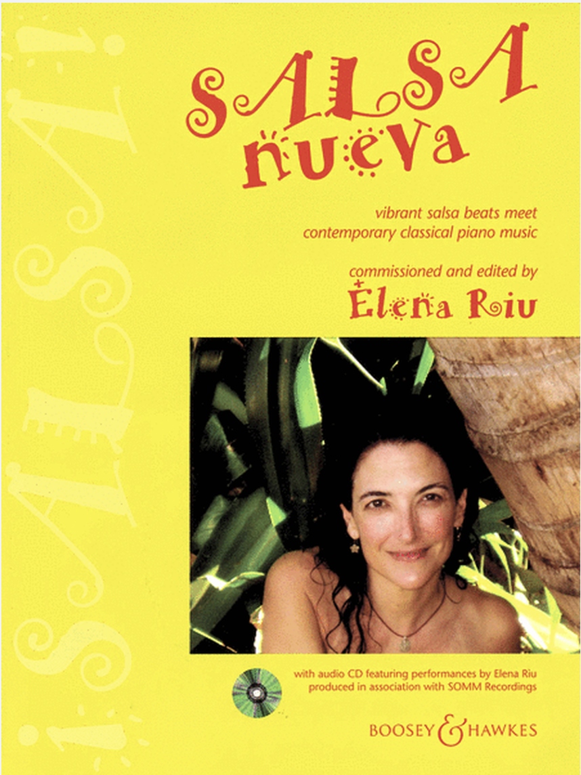
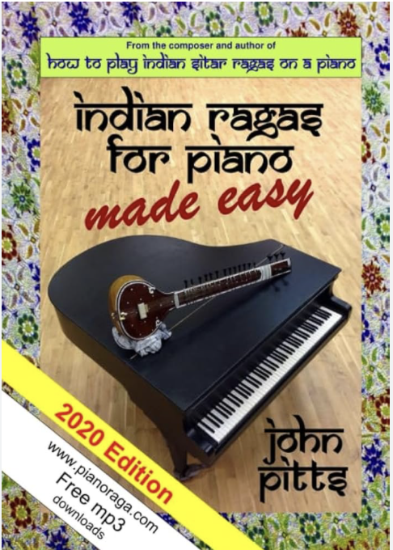
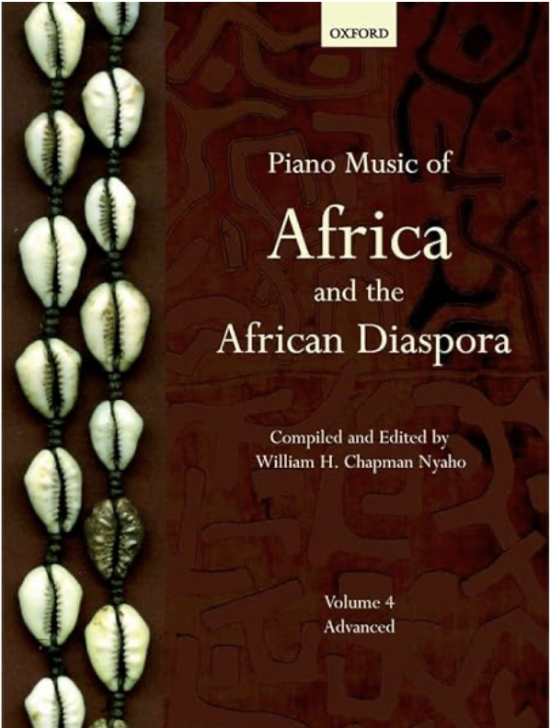
How to locate composers, appropriate pieces, & music scores?
Google
IMSLP.org
University Professors
Word of Mouth
Music Publisher Websites
Libraries/ Interlibrary Loan
New Anthologies of Music (many are leveled in difficulty)
Music Information Centres (https://www.iamic.net/)
PARIS, FRANCE

Slide 11
Community outreach
1
2
Area High Schools
Art/Cultural Museums
3
4
Retirement Homes/Memory Care
Hospitals/Medical Care Units

Slide 12
The University of Nebraska Omaha (UNO) Service Learning Academy supports UNO faculty members in developing service learning courses in collaboration with community organizations, governmental agencies, businesses, and P-12 faculty.

Slide 13
How we share our research:
Program Notes
Posters
Brief introductions to works before performing
Connections between poetry & music
YouTube recital during pandemic
Internships

Slide 14
Student reactions
NEW YORK, NEW YORK

Slide 15
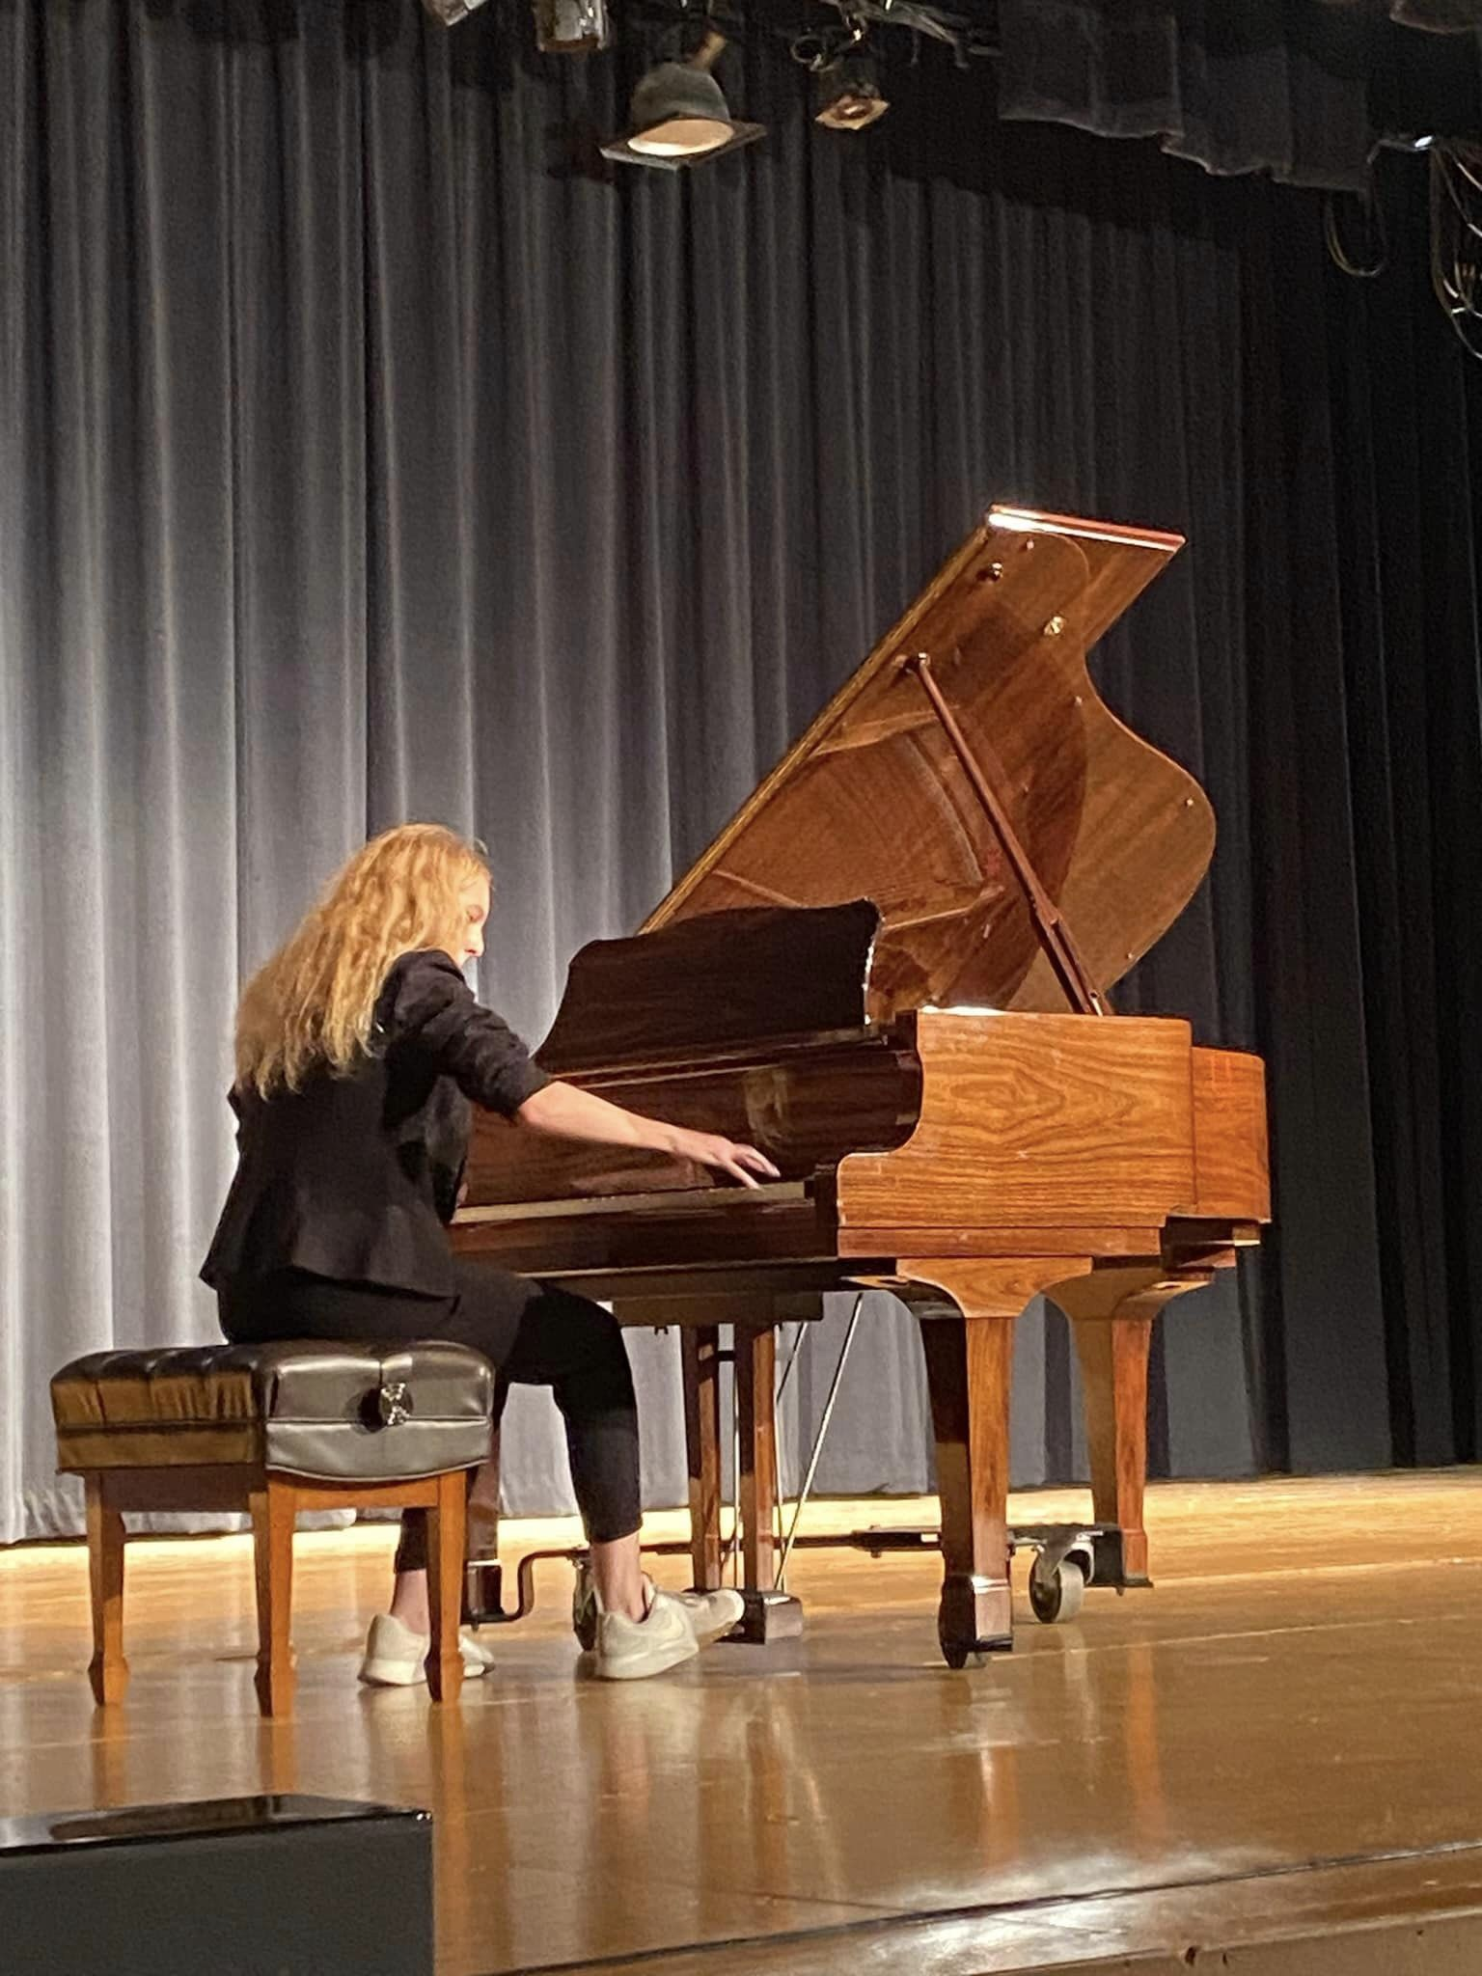
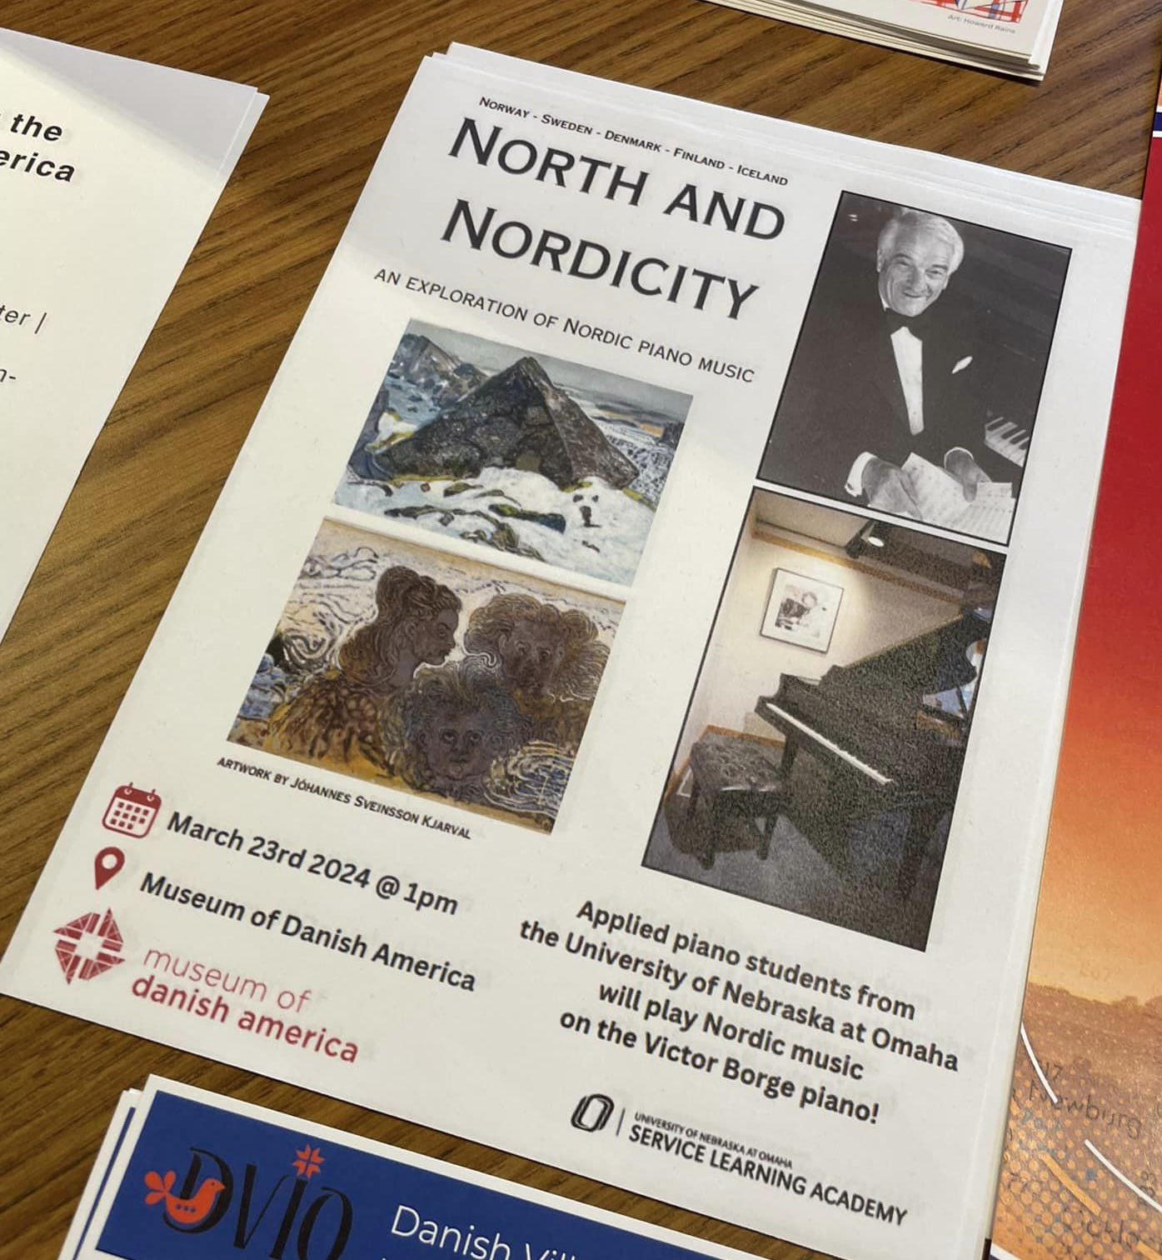
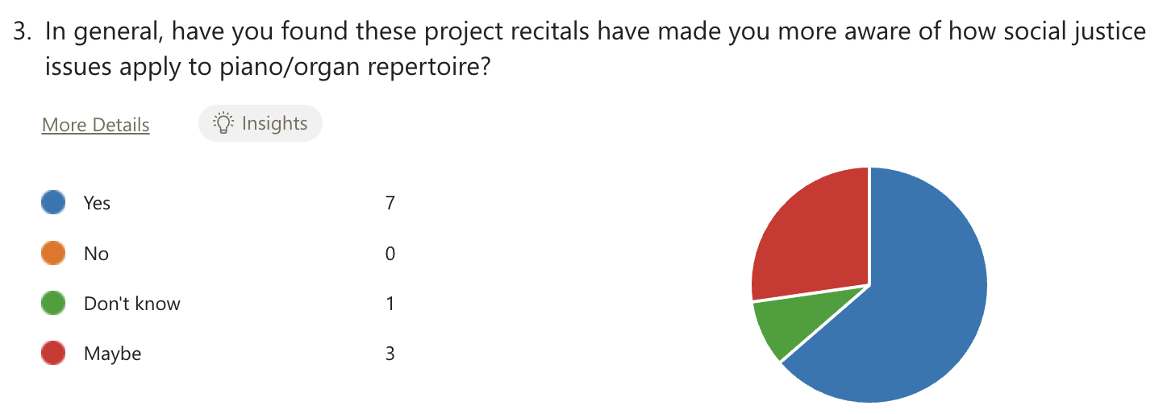

Slide 16
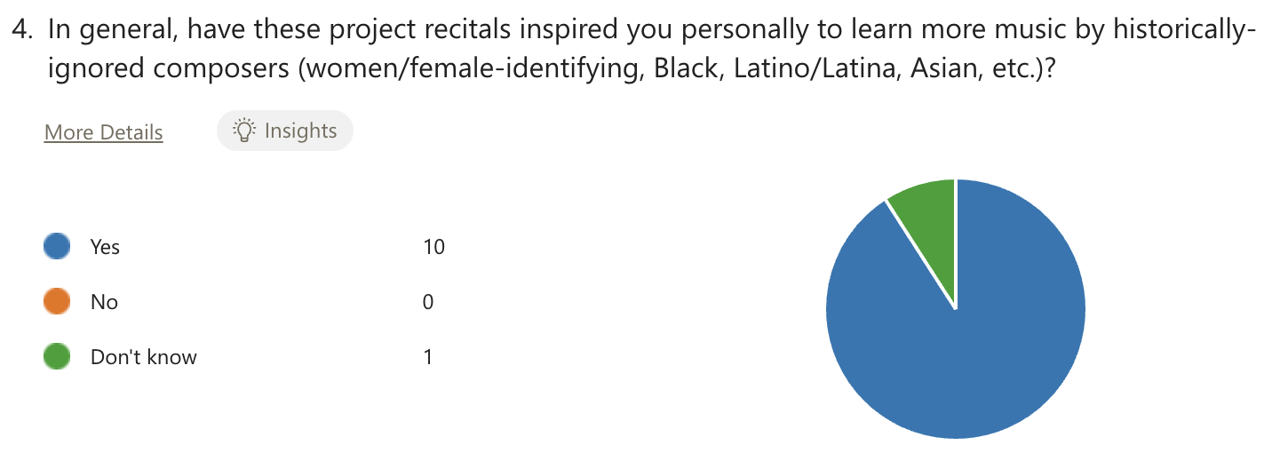
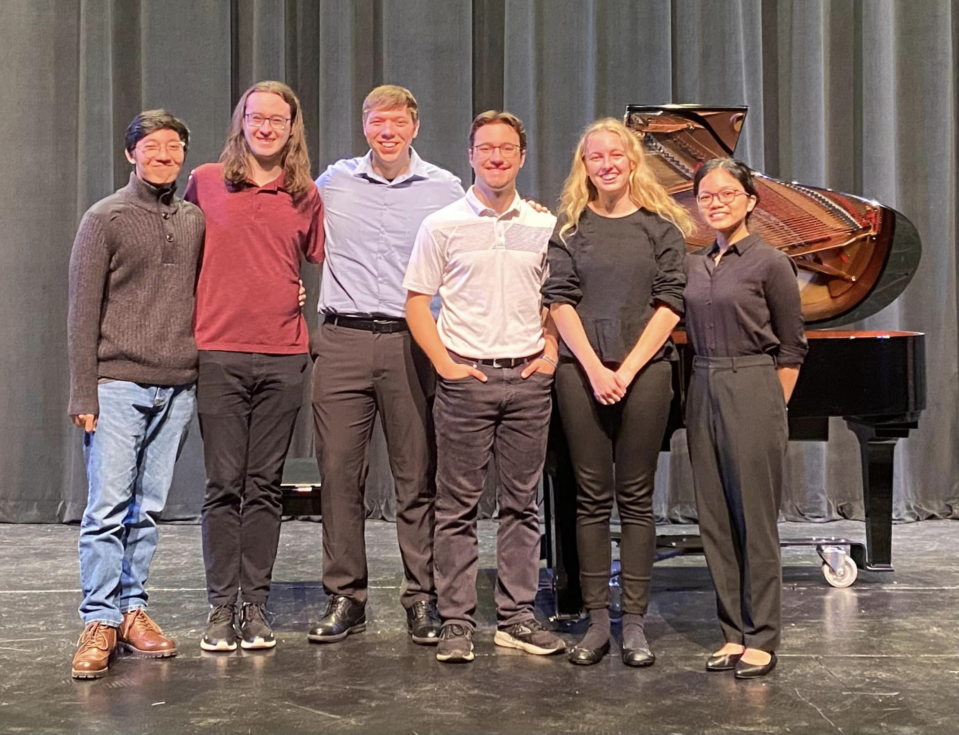
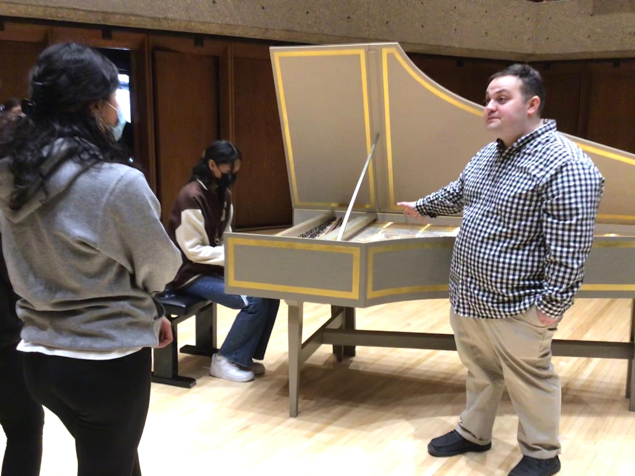
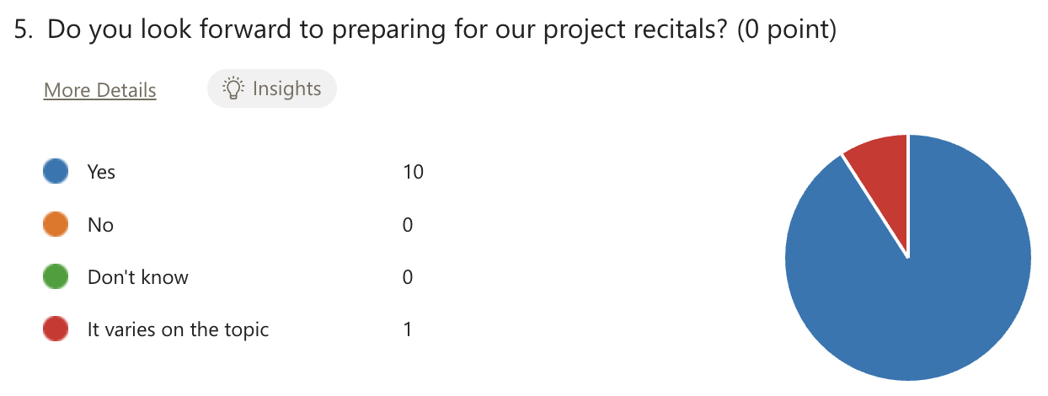

Slide 17
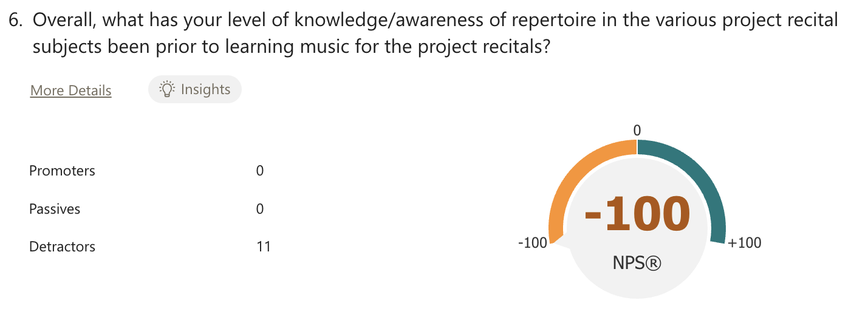
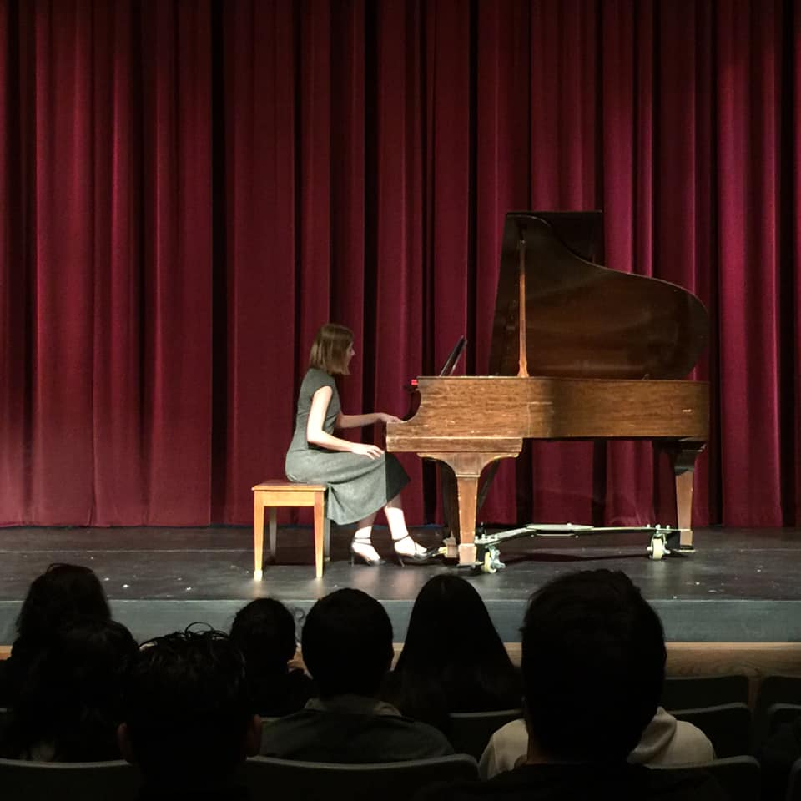
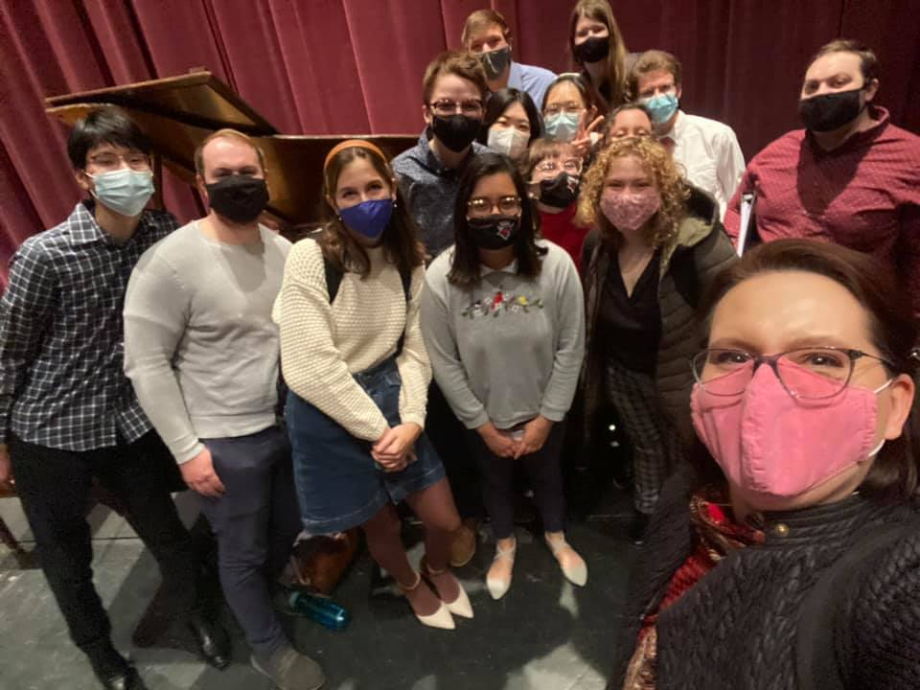
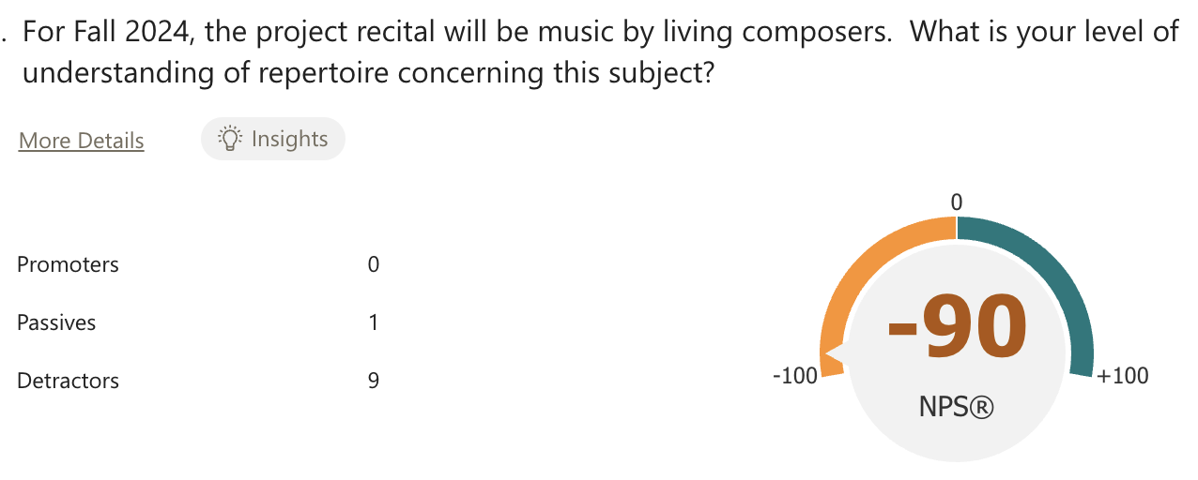

Slide 18
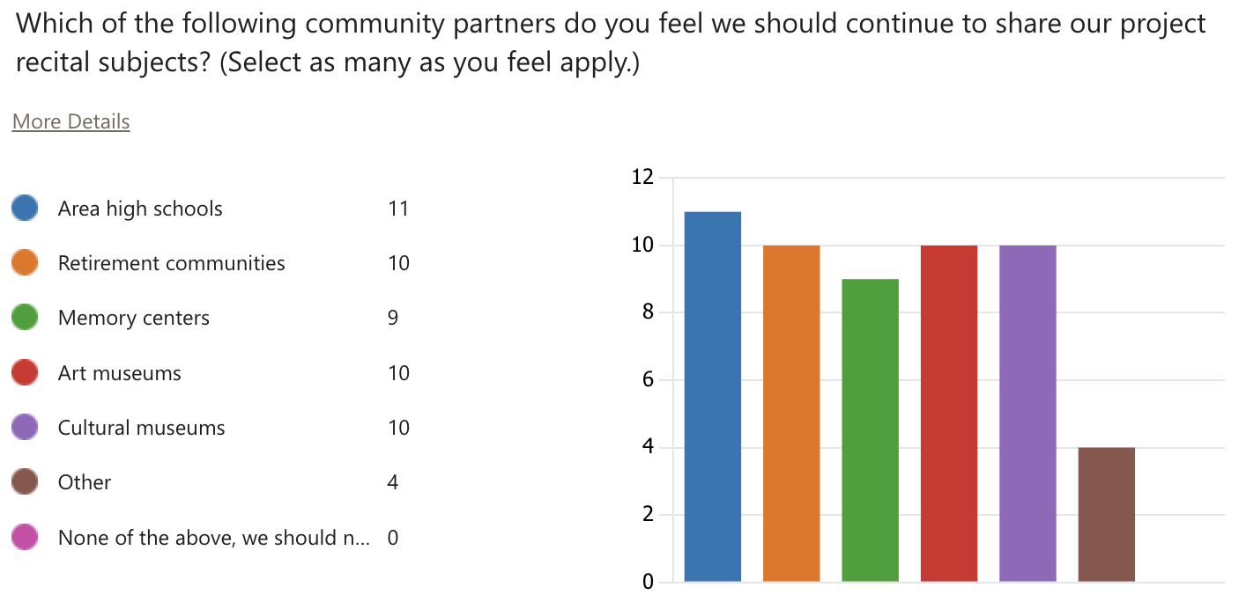

Slide 19
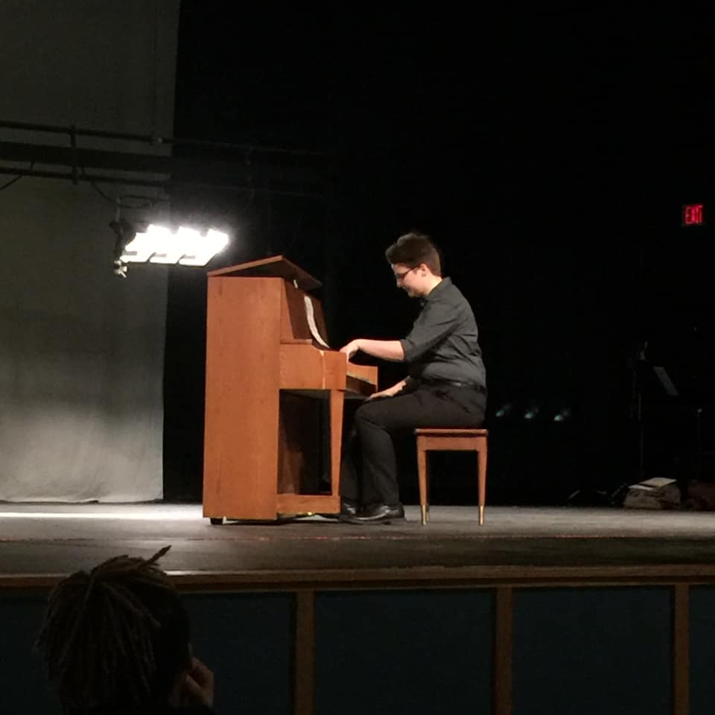
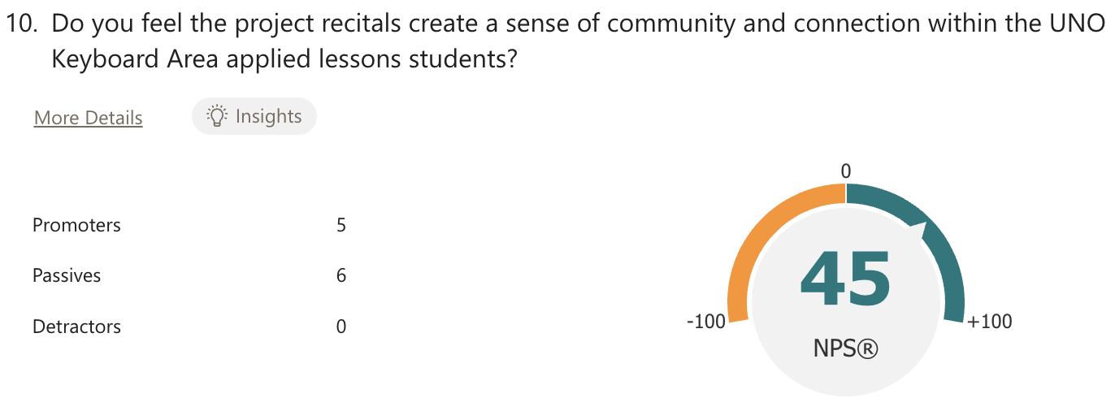
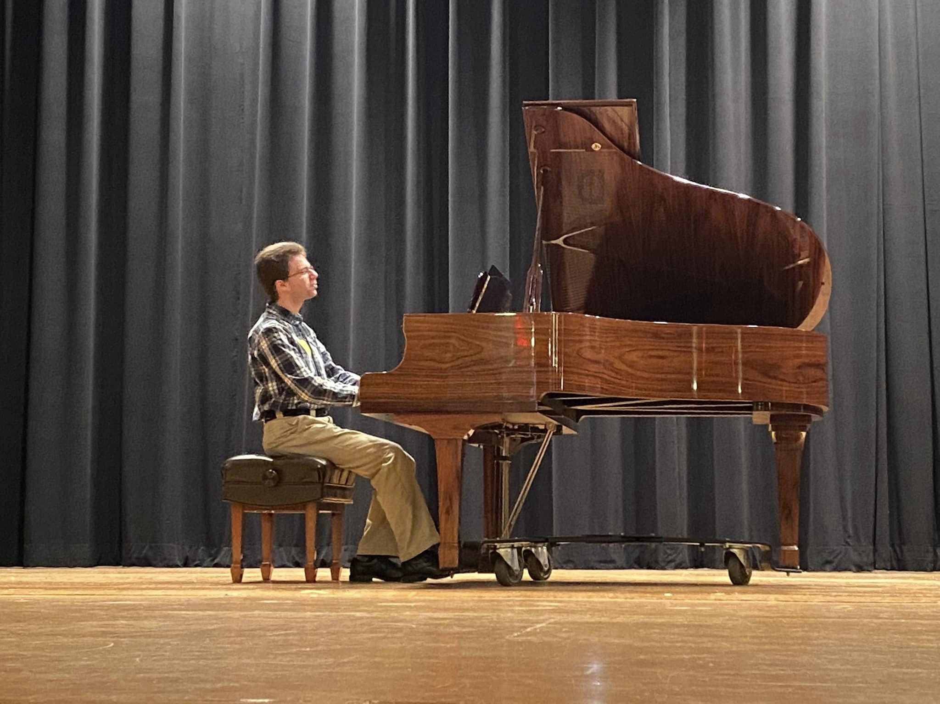
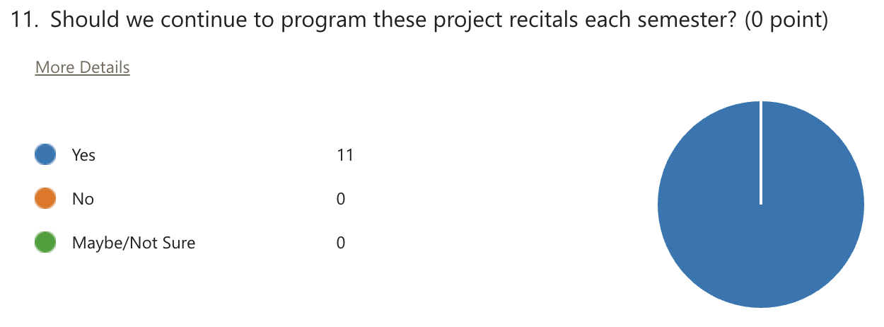

Slide 20
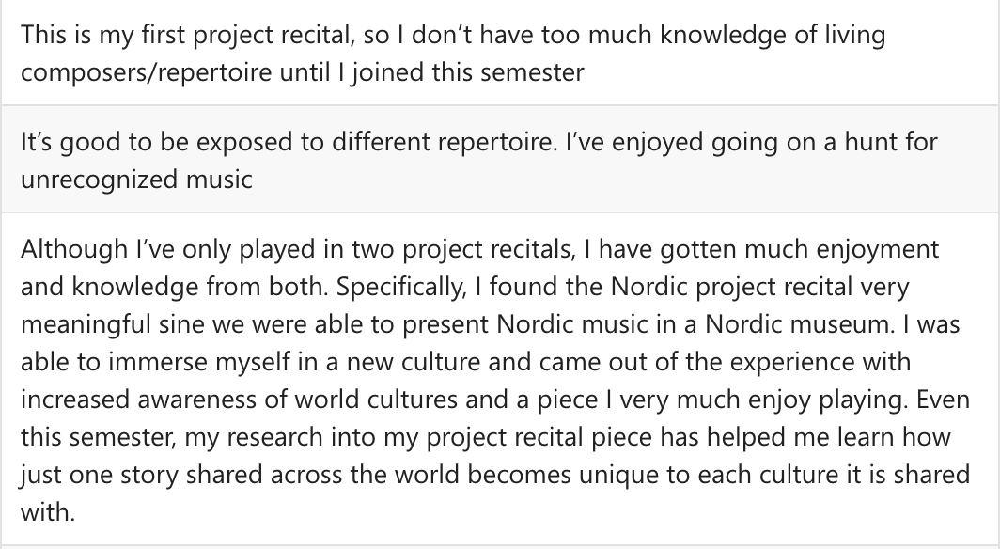
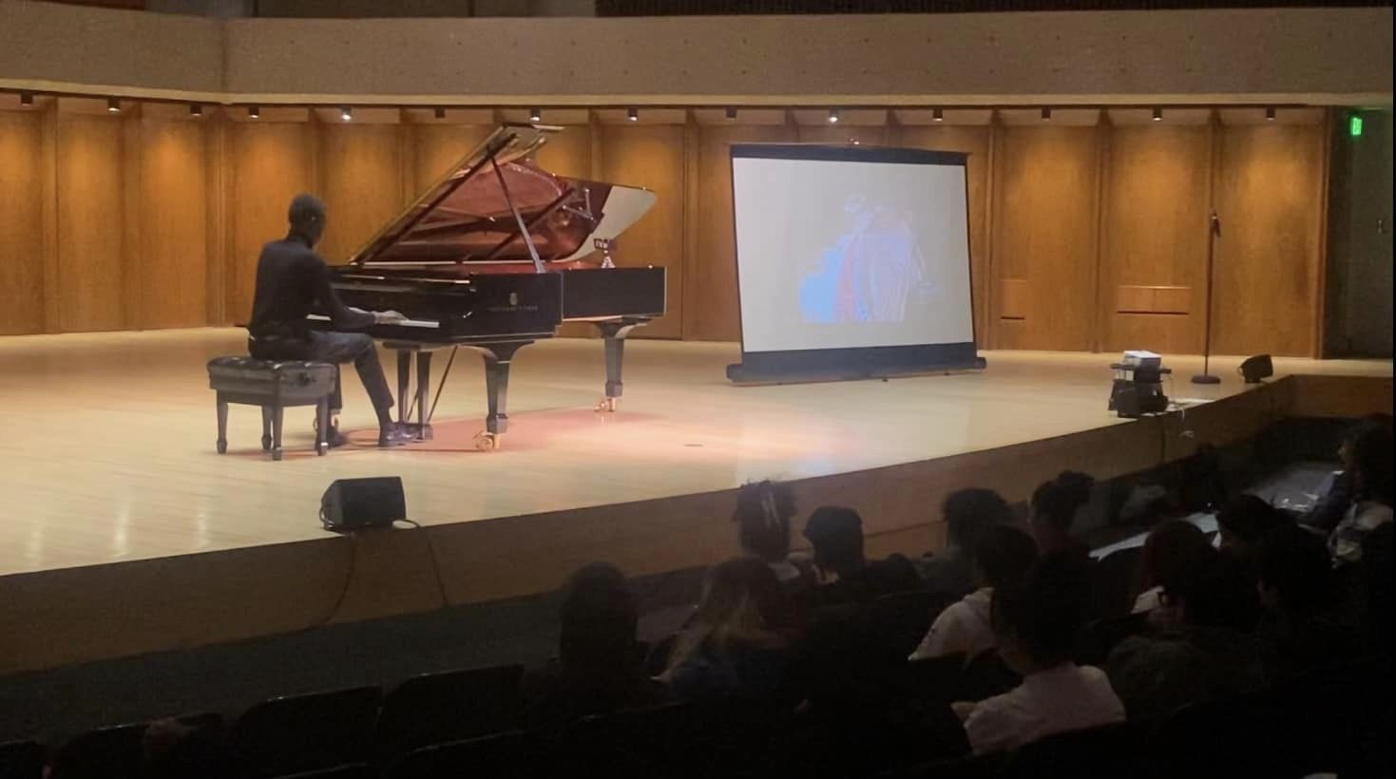
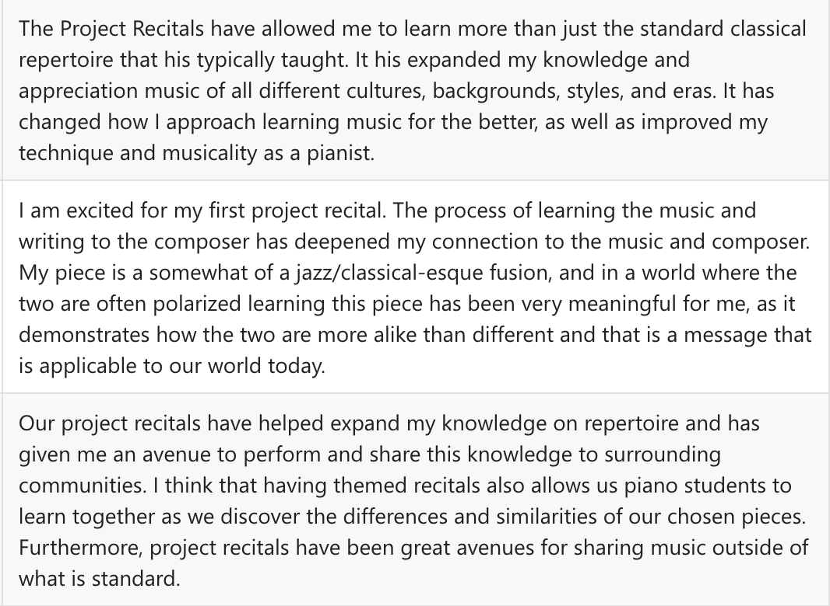
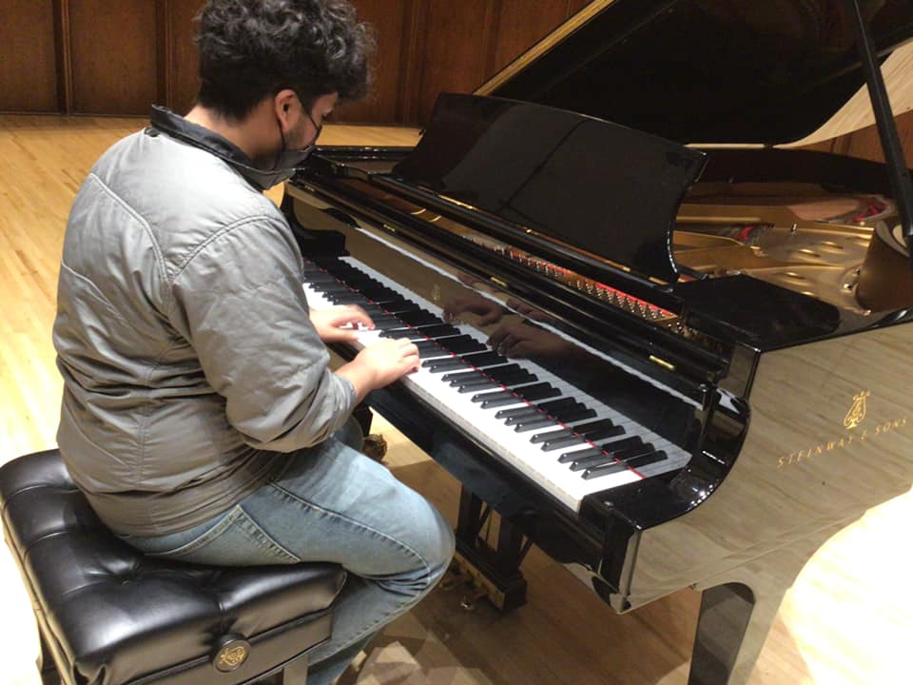

Slide 21
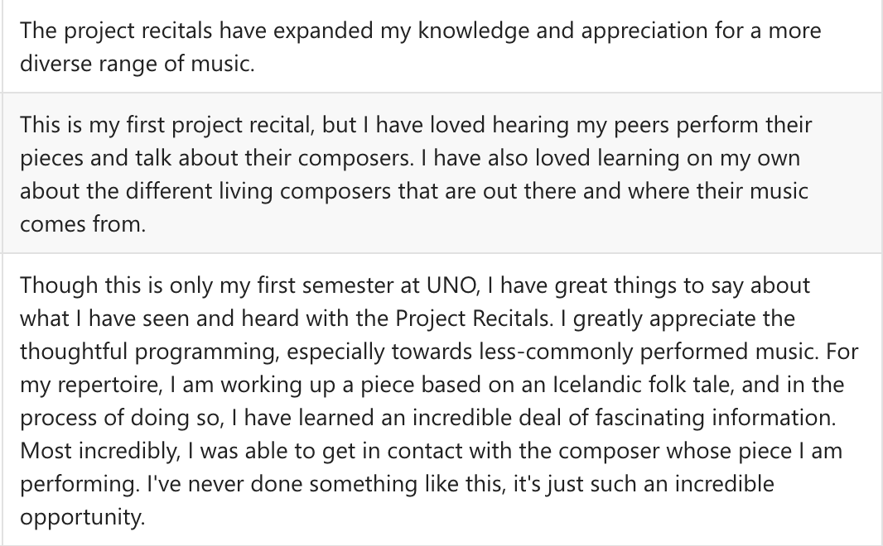
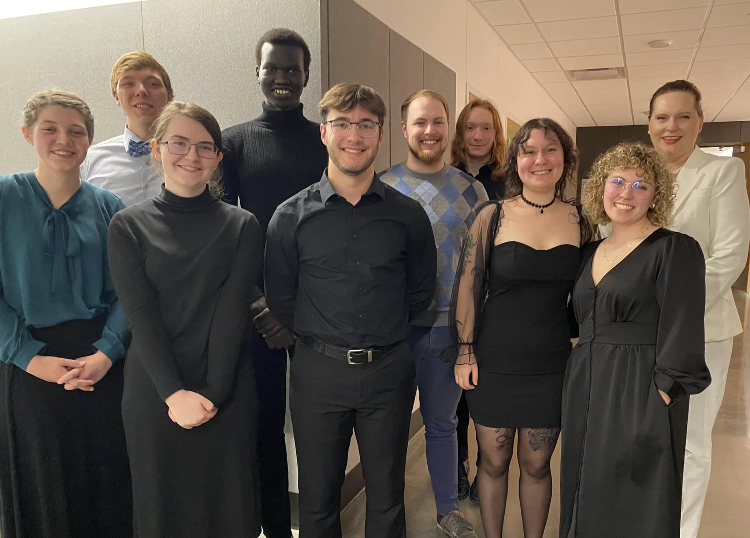
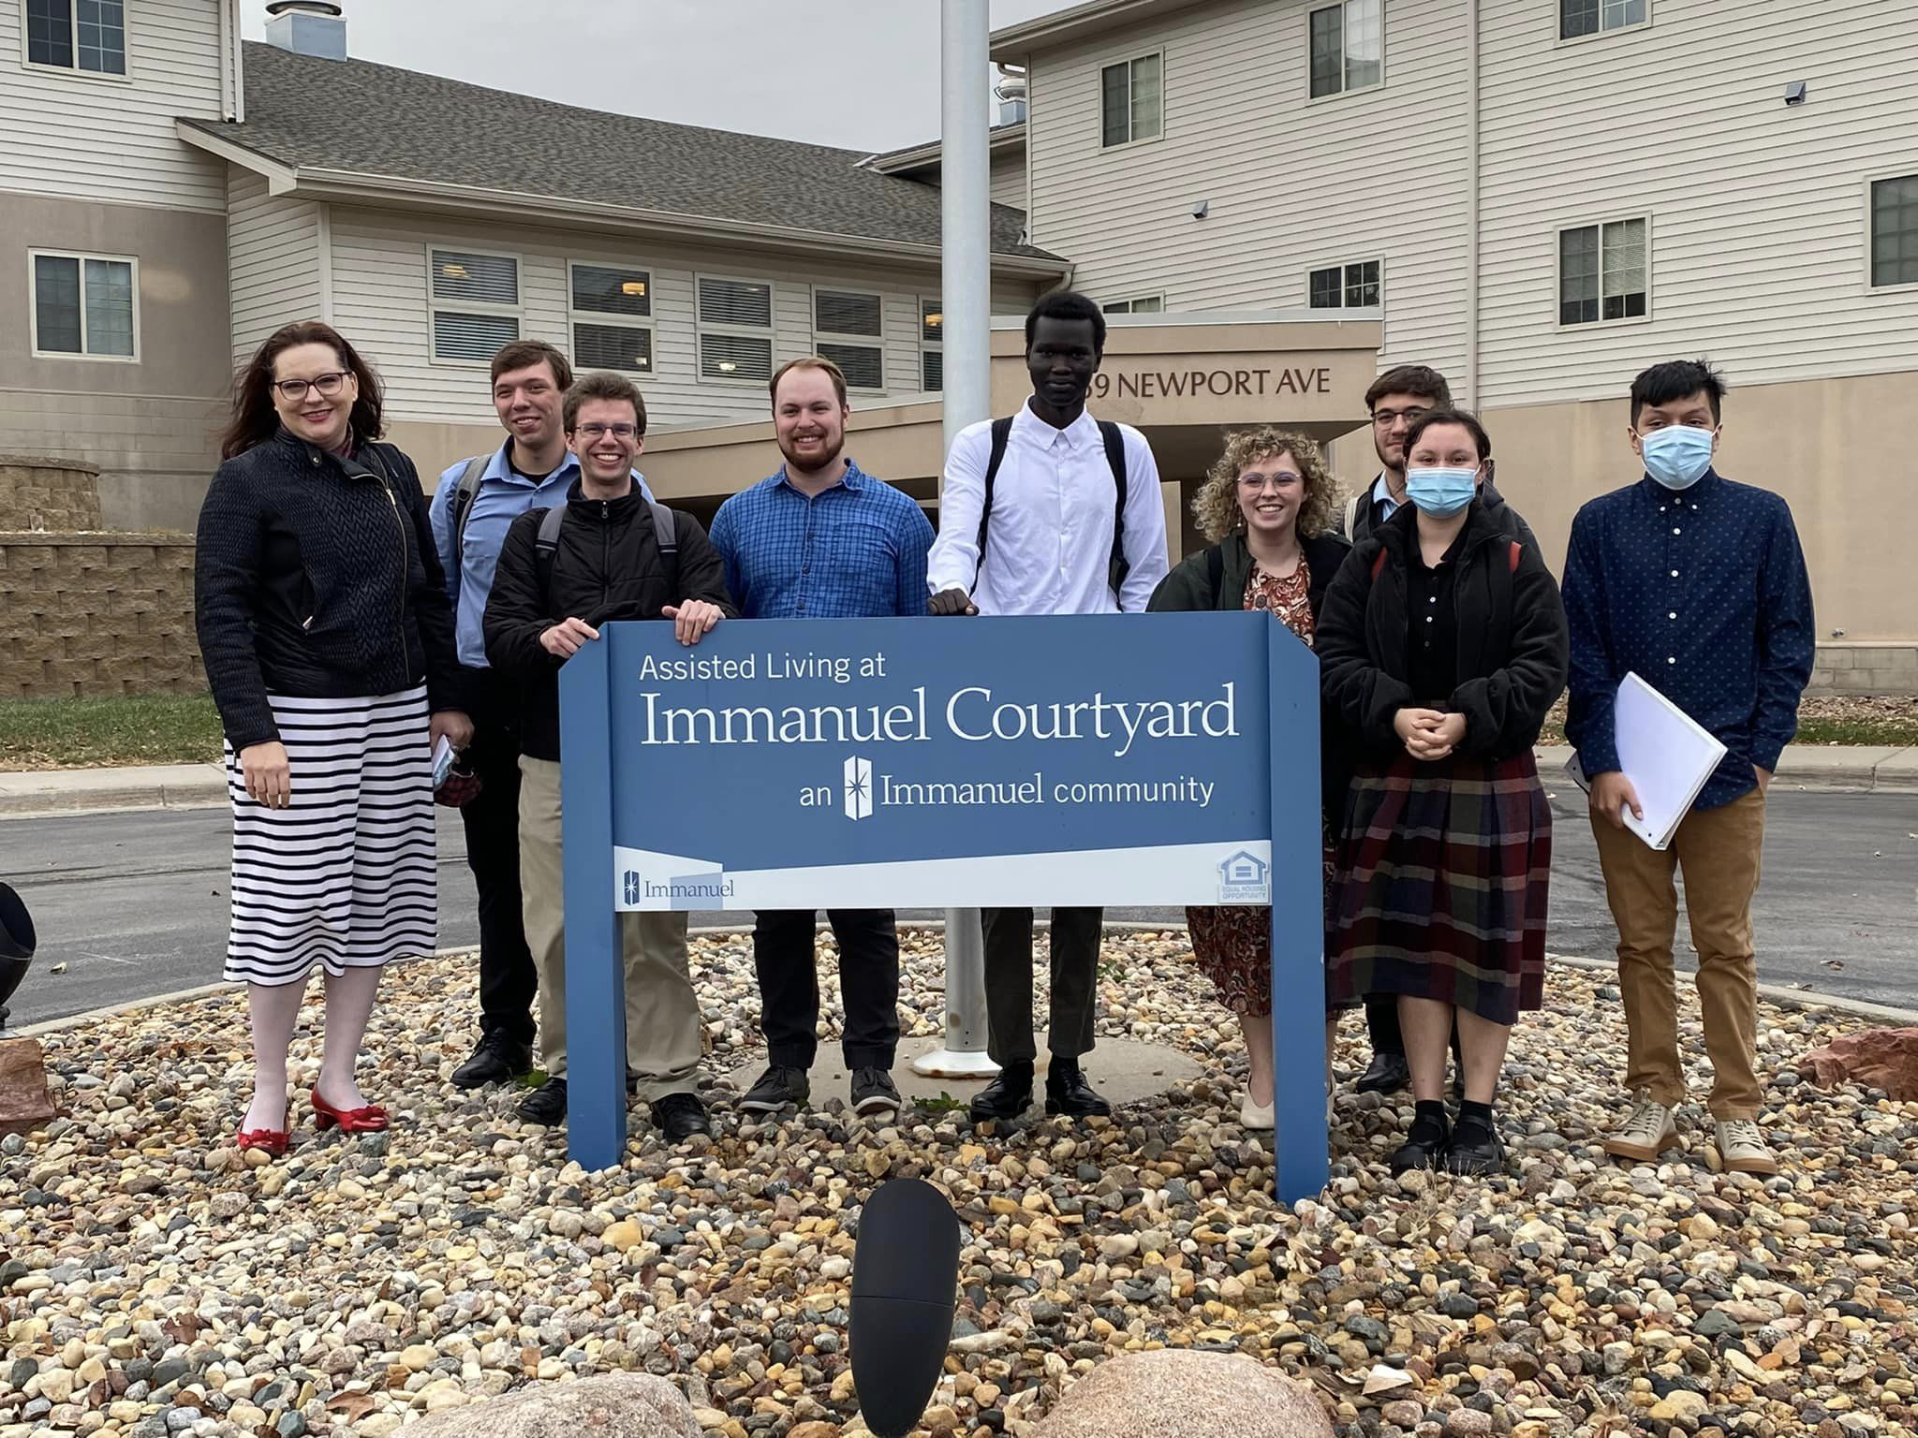
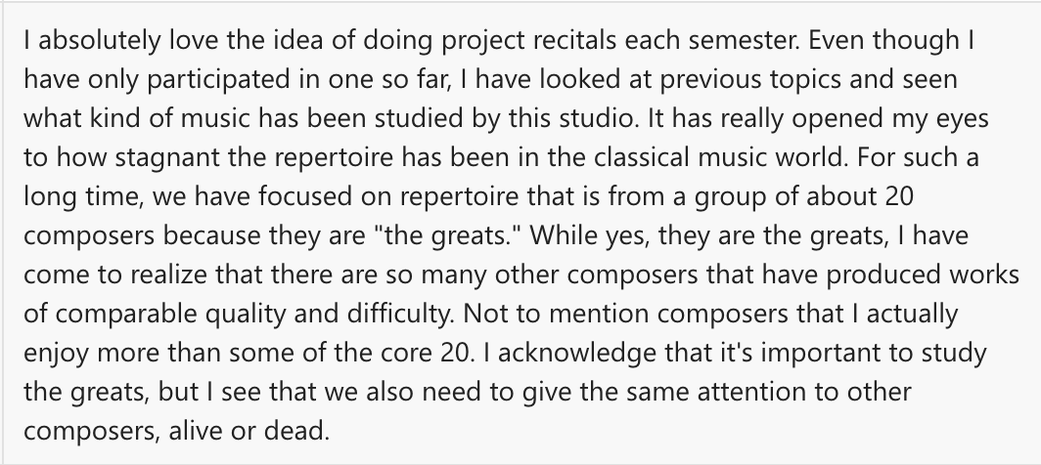

Slide 22
THANK YOU!
Omaha South high school –
left hand alone recital
High school visitation @ uno –
anything but baroque recital
Dr. Kristín Jónína Taylor
University of Nebraska at Omaha
kristintaylor@unomaha.edu
Danish-American museum –
Nordic Music Recital
Aksarben retirement community
Nocturnes recital

