Slide 1

A Singer’s Guide to Acting
Martina Goldring

Slide 2
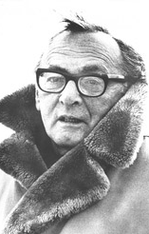
Acting is living truthfully under imaginary circumstances.
– Sanford Meisner

Slide 3
Key takeaways
Acting techniques
Breaking down a script
Finding a balance

Slide 4
Techniques
Just as with singing, there are different schools and approaches when it comes to acting technique
Technique evolves and new schools build on what the old teachers set down as a foundation
The most well-rounded actors study many different techniques and take what works for them to create their own approach
Three of the most influential acting teachers of the 20th century were Konstantin Stanislavski, Sanford Meisner, and Uta Hagen

Slide 5
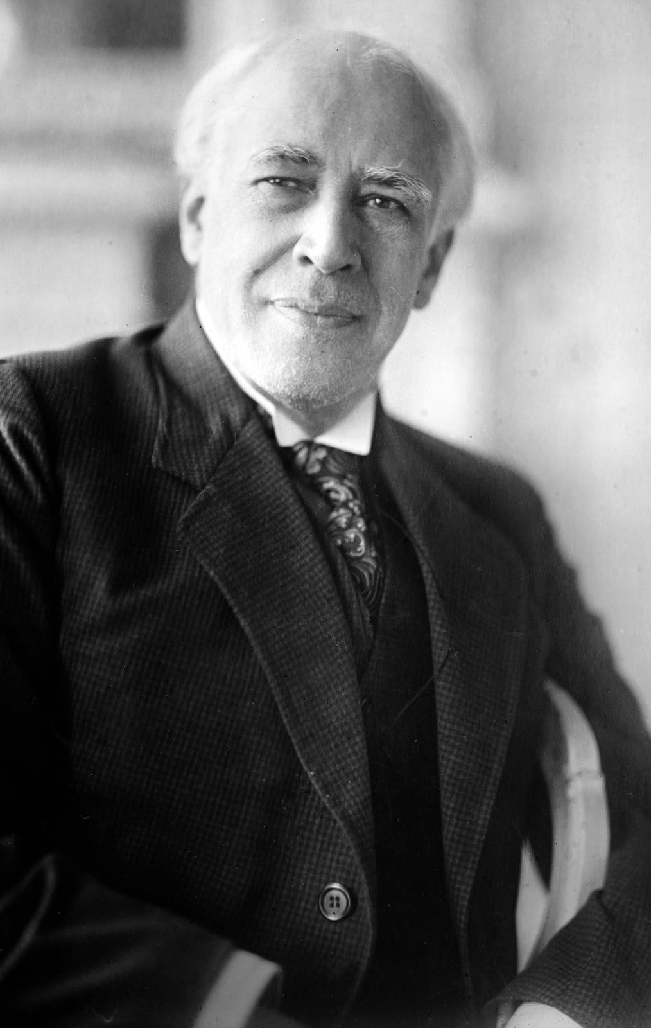
Konstantin Stanislavski
Through preparation and rehearsal, the Stanislavski system aims to create an emotionally expressive and authentic performance
Actors internalize their character’s inner life, including their motivations and emotional states

Slide 6
The Magic “If”
The actor should put themselves in the character’s shoes and consider what they would do if they were in that situation – this makes the character’s motivation the same as the actor’s
Given Circumstances
Specifics of the character that can be gleaned from the script (background, time, place, etc.)
Objectives
What does the character want?
Physical action
The actor must build a character’s behavior through specific, concrete, performable action
Emotional memory
The actor should develop their ability to observe emotional reactions in their daily lives. The emotional memories developed off-stage provide the actor with strong feelings to draw from when their character experiences a similar emotion on stage
Subtext
The meaning behind the words on the page (why a character says or does something)

Slide 7
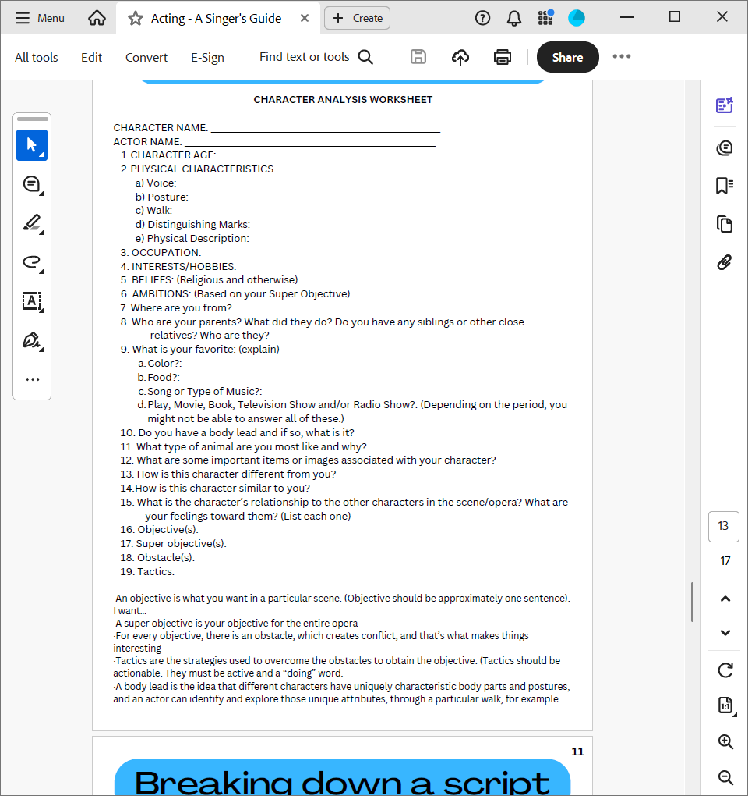
Creating a character derived from Stanislavski’s Building a character

Slide 8
Sanford Meisner
The goal of the Meisner approach is for the actor to not focus on themselves and instead concentrate on the other actors in the immediate environment
To this end, some exercises for the Meisner technique are rooted in repetition so that the words are deemed insignificant compared to the underlying emotion
In the Meisner technique, there is a greater focus on the other actor as opposed to one’s internal thoughts or feelings associated with the character

Slide 9
Emotional Preparation
Doing whatever is necessary to enter a scene “emotionally alive” – imagined circumstances or real personal memories
BUT after entering the scene, all action and reaction must be based organically on what other actors in the scene are doing
Repetition
Repetition exercises to develop skills of observation and instinct
Repetition gets actors out of their heads so they can rely on their organic instincts
Improvisation
All the preparation ultimately leads to improvisation and flexibility in a performance
An actor should not make any choices until something provokes them, thereby justifying their behavior

Slide 10
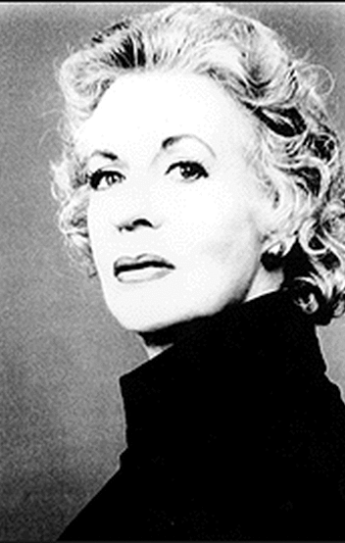
Uta Hagen
Hagen’s acting techniques encourage actors to avoid over-intellectualizing their processes and instead root themselves in rigorous observation of daily life
The five key elements of Hagen’s technique are substitution, transference, specificity, authenticity, and preparation

Slide 11
Representational acting vs. presentational acting
A representational actor is merely imitating a character’s behavior and is focused on how they are coming across to the audience
A presentational actor focuses less on how they are coming across, and believes that they will portray their character correctly when they can find their character in themselves (more truthful)
This can be achieved by developing a full sense of identity as a character and through emotional memory/substitution
The Play and the Role
A character is driven by objectives which they want to accomplish with every line, action, and stage direction
A character also has a super objective that they are trying to accomplish through the whole play

Slide 12
Breaking down a script
Beats
A scene is made up of beats/units of action. Go through your script with a pencil and mark in the beats
Objectives
Super objective – your character’s primary objective
Scene objective – your character’s objective for the duration of the scene
Beat objectives – your character’s objective for each unit of action

Slide 13
Example: Pamina in Die Zauberflöte
Ach, / ich fühl‘s, / es ist verschwunden, /
Ewig hin der Liebe Glück! //
Nimmer kommt ihr Wonnestunde
Meinem Herzen mehr zurück! //
Sieh‘, / Tamino, / diese Tränen, /
Fließen, / Trauter, / dir allein! //
Fühlst du nicht der Liebe Sehnen, /
So wird Ruh' im Tode sein! //

Slide 14
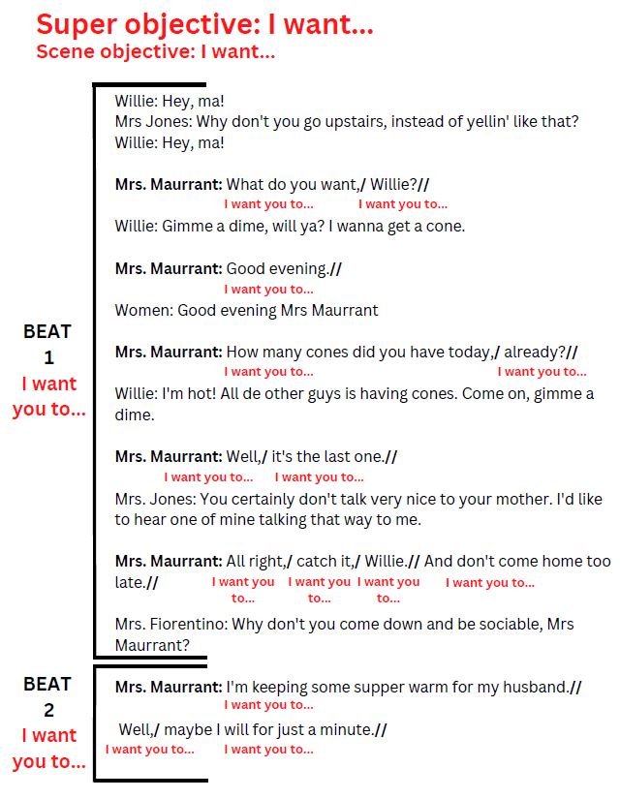
Example: Anna Maurant in Street Scene

Slide 15
Additional steps for music
Listen to the accompaniment
The text is only one part of the story. What is the accompaniment doing? How is it participating in the storytelling? How is it supporting or contradicting what you are singing about?
Listening to the accompaniment can give you the subtext that you need to better understand your character’s journey
Find meaning in the rests
It is easy to ignore the rests, and wait with anticipation for our next entrance, however the story continues. What does the silence mean?
Take a moment to understand the purpose of the rest. Is your character processing a new emotion? Changing their mind about something? Planning what to do next?
Source: @aspiring.opera.singers

Slide 16
Finding a balance
Opera is a theatrical form which requires a truthful and believable acting performance
“Park and bark” is no longer acceptable in the opera world
We must find emotional truth without it affecting the quality of our singing
We cannot let our emotions take us over so much that we can no longer sing with correct technique
An actor should be 90% in character and 10% aware that they are themselves on a stage

Slide 17
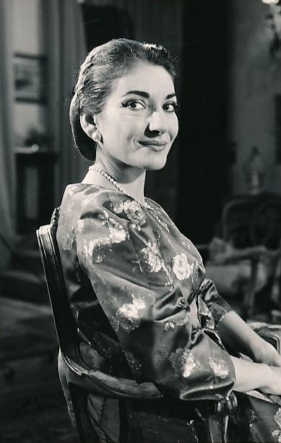
To sing is an expression of your being, a being which is becoming.
– Maria Callas
Maria Callas sings Vissi d’arte:
https://www.youtube.com/watch?v=NLR3lSrqlww

